Slide 1
Guess that Theory!
Language Development SP2022

Slide 2
Guess That Theory!
Can you guess which theoretical approach the authors of the following articles endorse?
Use the clues in the abstracts to make your guess!

Slide 3
Guess That Theory!
Remember, here are your major contenders:
Behaviorism
Nativism
Usage-Based Approach
Social-Pragmatic Approach
Connectionism (and Competition-Based Models)

Slide 4
Abstract #1

Slide 5
Guess That Theory!

Slide 6
Guess That Theory!

Slide 7
Usage-Based!

Slide 8
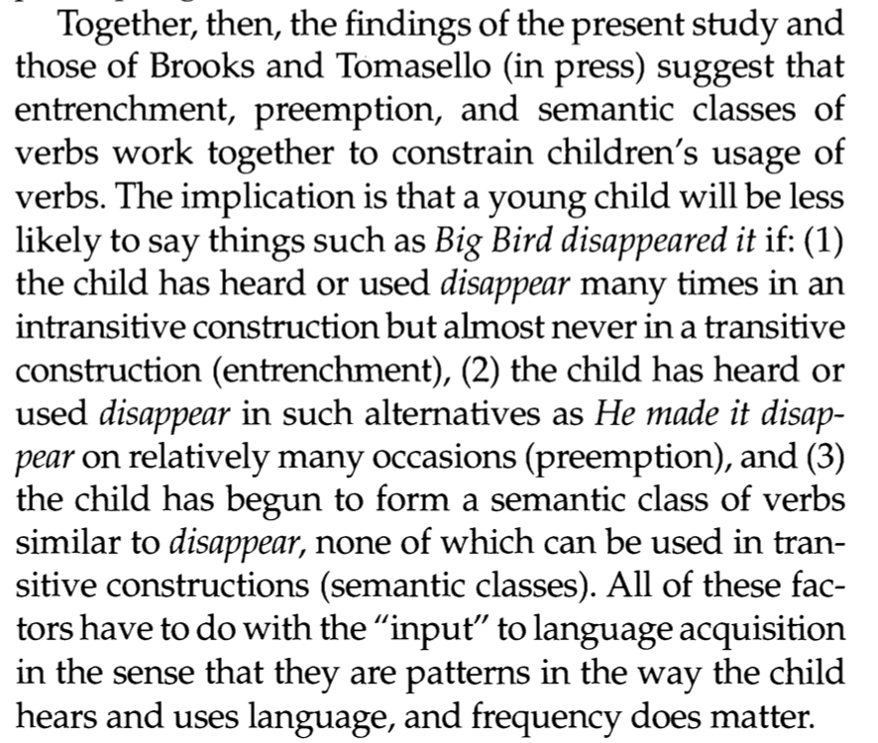
Guess That Theory!

Slide 9
Abstract #2

Slide 10
Guess That Theory!

Slide 11
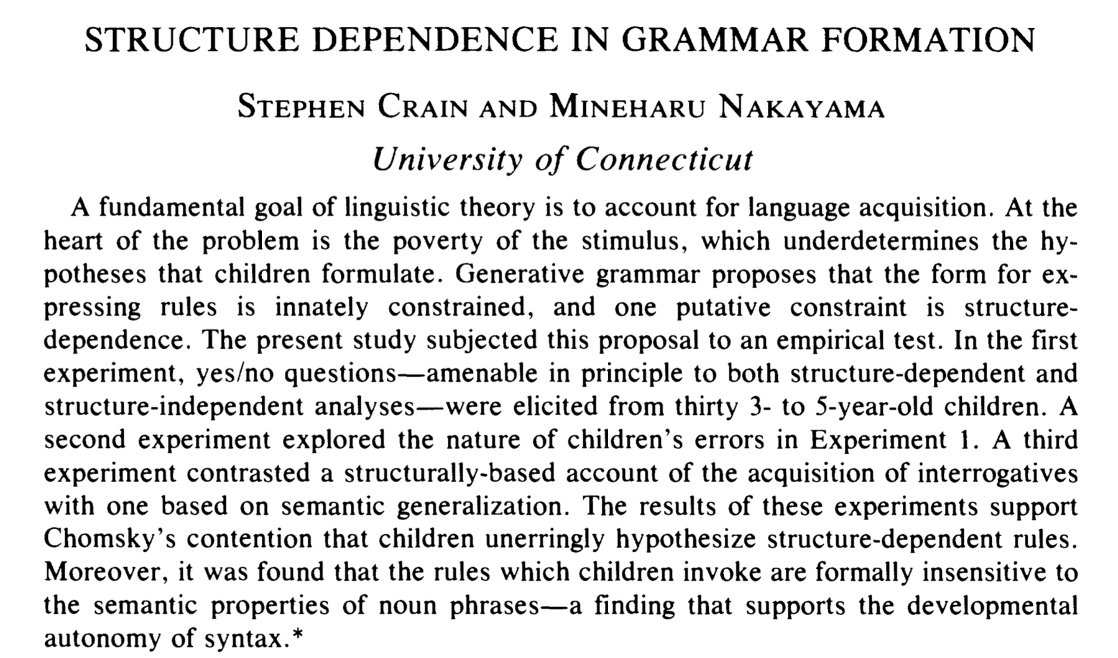
Guess That Theory!

Slide 12
Nativist!

Slide 13
Guess That Theory!

Slide 14
Abstract #3

Slide 15
Guess That Theory!

Slide 16
Guess That Theory!

Slide 17
Usage-based!

Slide 18
Guess That Theory!

Slide 19
Abstract #4

Slide 20
Guess That Theory!

Slide 21
Guess That Theory!

Slide 22
Connectionist/Competition!

Slide 23
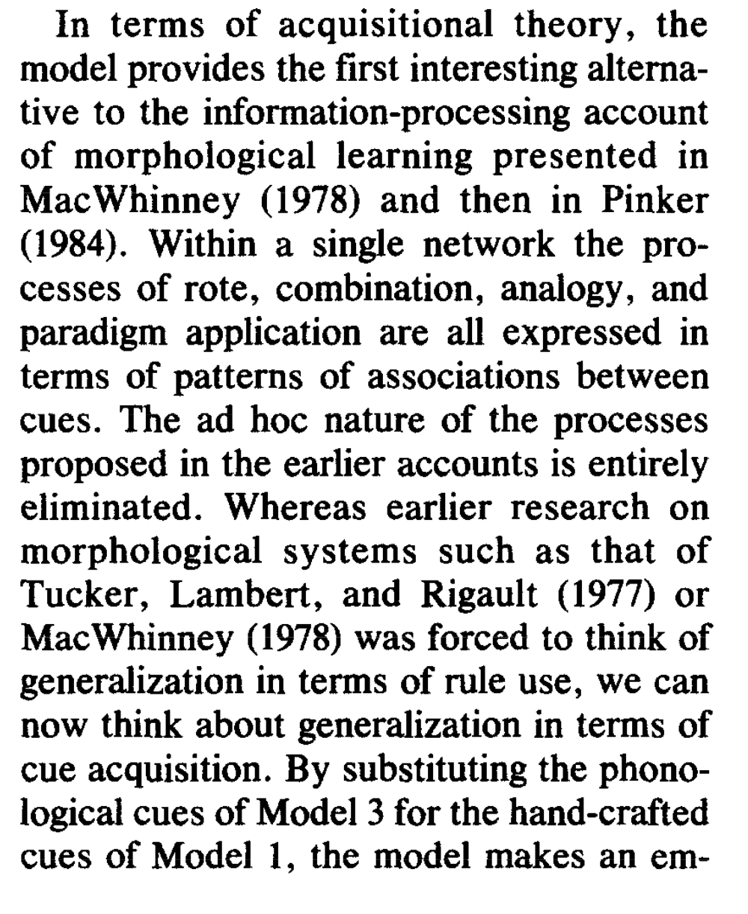
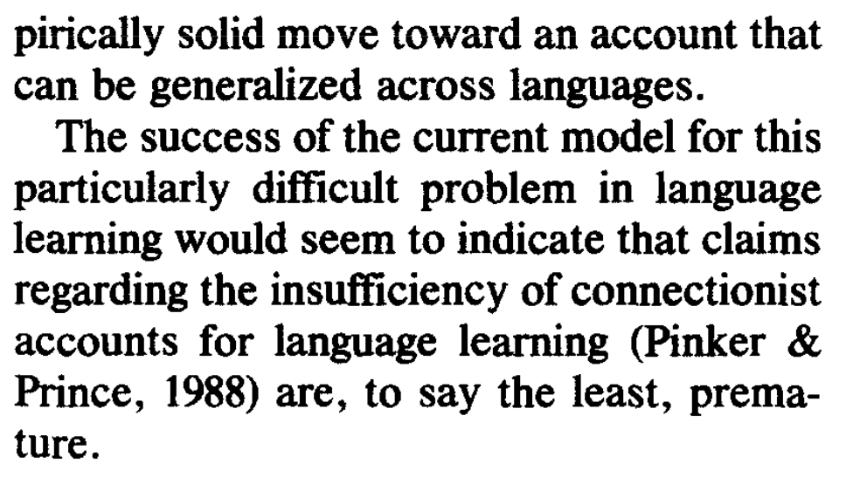
Guess That Theory!

Slide 24
Abstract #5

Slide 25
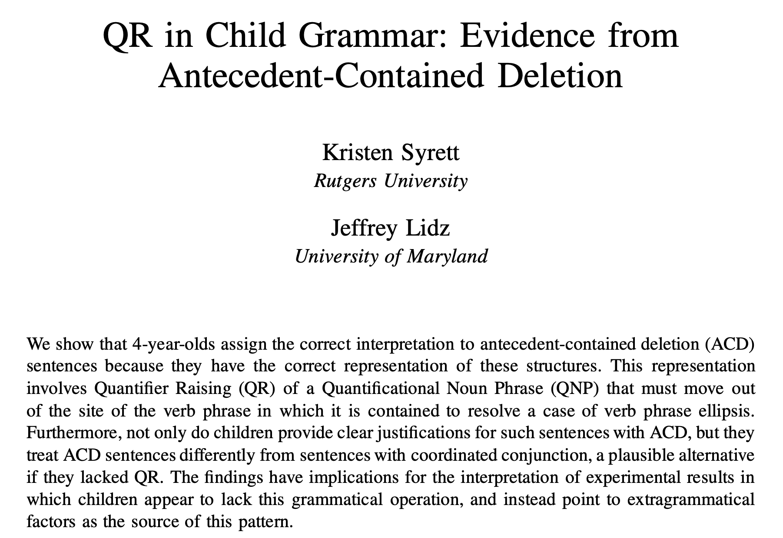
Guess That Theory!

Slide 26
Guess That Theory!

Slide 27
Nativist!

Slide 28
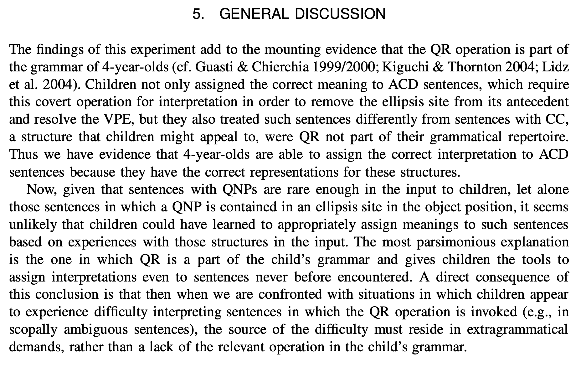
Guess That Theory!

