Slide 1
Development and Characterization of Diclofenac Sodium loaded Liposomes for Transdermal Delivery
Jailen Doyle
Dillard University
Mentors: Bozena Michniak-Kohn, PhD
Namrata Martharoo, PhD Student
Keyaara Robinson, PhD Student
Notes:
Attention grabber: “Raise your hand if you know anyone with arthritis or if anyone is currently affected by arthritis”
Introduction of topic and mentors

Slide 2
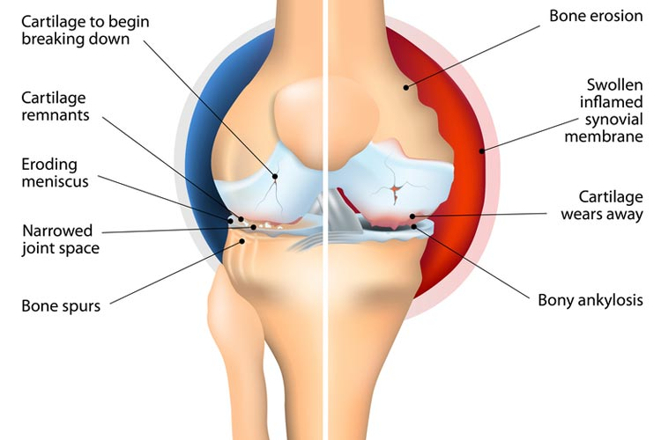
Introduction:
Osteoarthritis affects around 300 million people around the world every year.
It is a chronic condition involving:
cartilage loss
degeneration of the joints
nerve damage
chronic inflammation
Diclofenac sodium is an anti-inflammatory drug that stops the overexpression of pro-inflammatory enzymes.
Binds to pro-inflammatory enzymes, COX1, COX2, & 5-LOX
Diclofenac permeates skin
Decrease in inflammation
Enters soft tissue
Notes:
Osteoarthritis is a chronic degenerative disease that affects millions
The drug is absorbed through the skin, and permeated into the soft tissues surrounding the targeted joint. Once delivered, the inhibits the targeted enzymes, hence, also inhibiting inflammation.

Slide 3
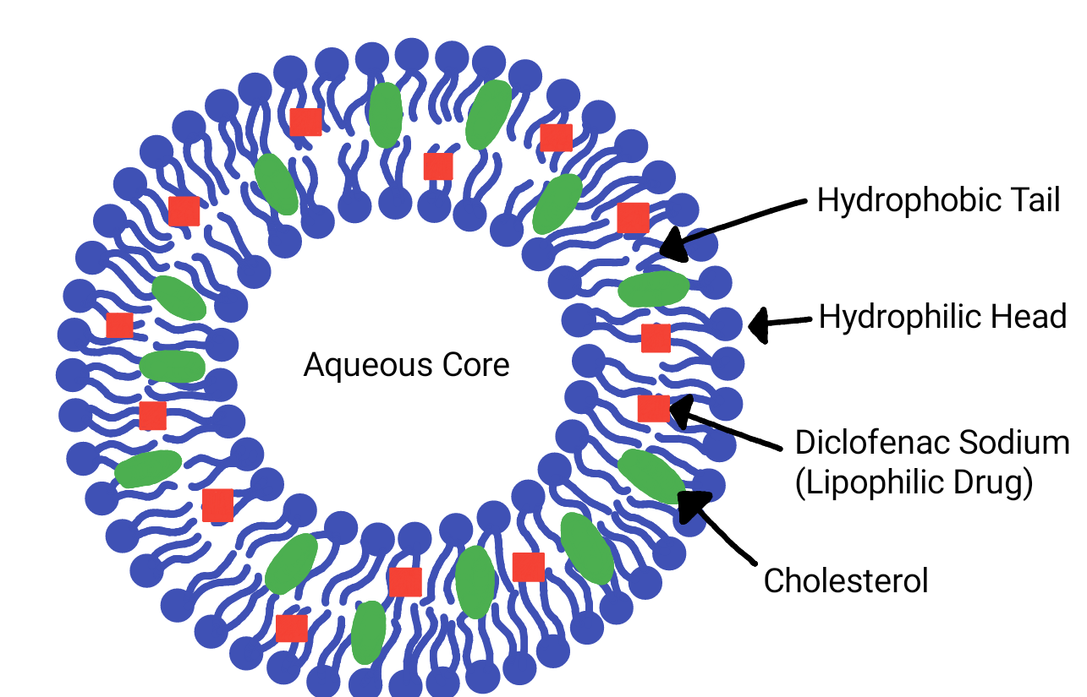
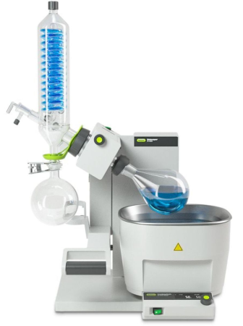
Materials & Methods:
Formulation Composition:
Lipoid S75 - 70 or 80 mg
Cholesterol - 30 or 20 mg
Diclofenac Sodium - 1-10%
Filtered particles were characterized using Zetasizer. Amount of Diclofenac sodium was analysed using HPLC.
Dissolved in
Chloroform : Ethanol(9:1)
Evaporate organic solvents and formation of thin film of liposomes
Hydrated with phosphate buffered saline & sonicated for an hour.
Notes:
Transition of liposome zoom in

Slide 4
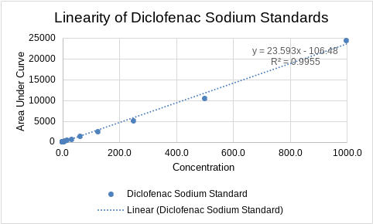
Results and Discussions:
Targets:
Particle Size ~ 300 d. nm ± 50 d. nm
PDI ~ 0.3 ± 0.1
Encapsulation Efficiency ~ 60%
results pending
Formulation | Composition Lipoid S75 : Cholesterol | Particle Size (d.nm) | PDI
DF1 | 70 : 30 | 511.9 | 0.474
DF2 | 70 : 30 | 523.0 | 0.497
DF3 | 80 : 20 | 217.2 | 0.213
DF4 | 80 : 20 | 342.2 | 0.324
Notes:
Results are currently pending for encapsulation efficiency, we are testing concentrations from about 50 mg - 100 mg

Slide 5
Conclusions:
Acknowledgements:
This study hopes to demonstrate that liposomes are an effective drug delivery vehicle for diclofenac sodium. Thus, a diclofenac sodium liposome nanoparticles can be delivered effectively via a transdermal route.
Thank you to the Drug Delivery Lab, Center for Dermal Research, New Jersey Center for Biomaterials, and Aman Armaan Ahmed Family for the supplies and support. Thank you to Dr. Bozena Michniak-Kohn, Namrata Martharoo, and Keyaara Robinson for the mentorship and guidance.

