Slide 1
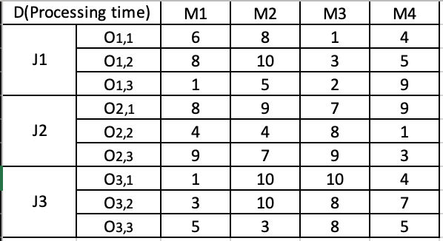
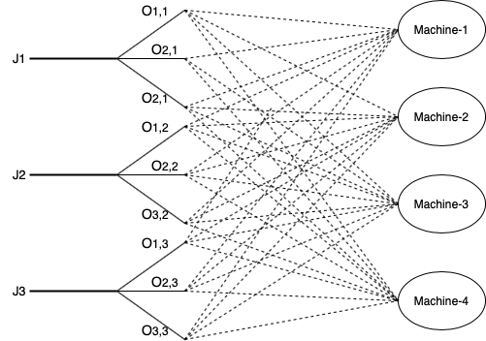
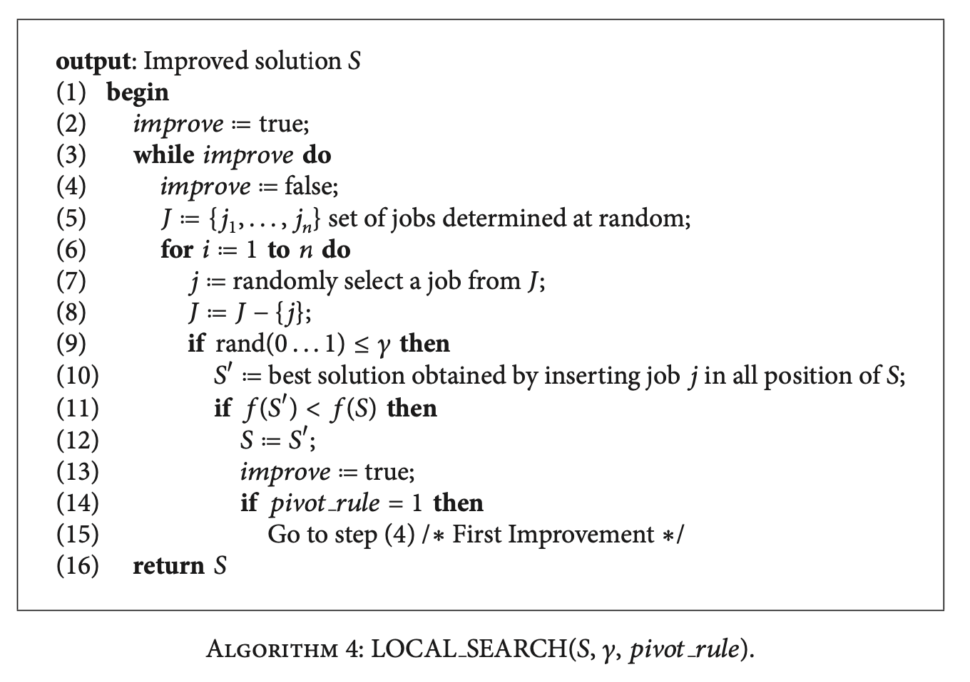
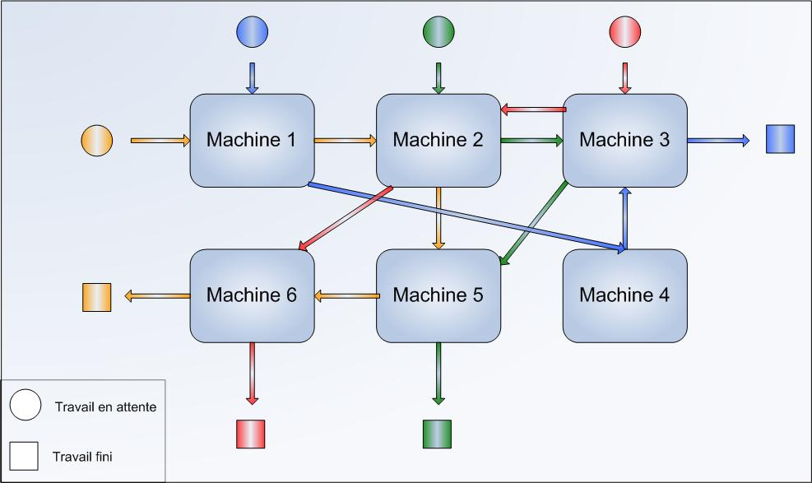
Modeling and Operations of Manufacturing System for individualized Products
^{Dr. Xi Gu, Ruiming Zhang}
Department of Mechanical Engineering
Abstract
Objectives
Discussion
We formulated the relevant algorithm based on the procedures of the real production process from my last internship where the company produces the starch-molded injecting fruit snack. We model the additive mixing system (AMS) with the multi-machine using mixed-integer programming. The formulation aims to study the flexibility of the mix integer programming to obtain the characteristics from the different batch requirements. We firstly working on the formulation of the algorithm. Then, we input the codes into the MIP solver, which is computer software to solve complex mathematical problems. The outcomes we expected is the completion time under different parameters. We will use the outputs to demonstrate the capability of the formulation. The results reflect the effectiveness of the formulation and we can use the data to show how much we can improve to make the process more efficient.
Explore different algorithms to solve the complex formulation
Minimize different objectives (ex. Tardiness, Earliness & WIP)
Find the optimal schedules for each job to be assigned at the most available workstation according to the precedence.
Determine the flexibility and capacity of the algorithms to be applied at larger scales.
Compare the effectiveness of the alternative solutions generated from the Gantt Charts
Traditional Scientific Methodology:
Genetic Algorithm (GA)
Heuristic optimization algorithm based on biological evolution. GA mostly shows good results at single machines system. The algorithm has low computational time, which fits the factory-wide scheduling problems.
Ant Colony Optimization (ACO):
ACO is closely related to the multiple entities system approach, which consists of many agents that interact with each other. Based on the previous research, ACO is good at solving the unrelated parallel machines and decomposition system. Because it is inspired by the ant colony philosophy that automatically decide the hierarchy.
Modern (Commercial) Methodology:
CP Solver is a Toolbox launched by IBM for solving the real-world operational planning and scheduling problems. It is like many industry scheduling software that designed for job-shop, open-shop and flow-shop problems. The solver is also compatible with specialized algorithms, such as GA or ACO. Researchers can perform higher level of computational scheduling problem.
References:
Golmohammadi, A., Bani-Asadi, H., Zanjani, H. J., & Tikani, H. (2016). A genetic algorithm for preemptive scheduling of a single machine. International Journal of Industrial Engineering Computations, 7(4), 607-614. doi:10.5267/j.ijiec.2016.3.004
Li, G., & Wu, Z. (2019). Ant colony optimization task scheduling algorithm for SWIM based on load balancing. Future Internet, 11(4), 90. doi:10.3390/fi11040090
Waschneck, B., Altenmüller, T., Bauernhansl, T., & Kyek, A. (2016). Production scheduling in complex job shops from an industrie 4.0 perspective: A review and challenges in the semiconductor industry. Paper presented at the Retrieved from http://publica.fraunhofer.de/documents/N-445710.html
Methods
Step I: Define Variables & Parameters based on Assumption
N: Number of jobs, i = 1, …, N
J: Number of periods, j = 1, …, J
O: Operation of Job I, o = 1, …, O
Ck: Completion time in position k
Tk: Tardiness of job in position k
D: Processing time
Figure 5: Initialize the processing time under different conditions
Step II: Establish Flowchart of Machine Selection & Algorithm
Figure 6: Process mapping the available combinations between jobs, operations and machines. Figure 7: Researched computer algorithm to build loops for the scheduling precedence.
Step III: Preliminary Setup of the Outcomes (Gantt Chart)
Figure 8: Using Gantt Chart to arrange the jobs according to the machine selection process and calculate the value of Makespan.
Figure 1: Introducing the additive mixing system for food production.
Figure 2: Value stream mapping the process flow of detailed tasks
Background
The open shop scheduling problem is deeply impacting the operations for manufacturing companies. It enables the enterprise to have higher productivity as well as more a balanced coordination between the machines and jobs. However, the previous industry researches were based on the deterministic level. The impact and effectiveness of the open shop scheduling algorithms need to be further implemented in realistic situations for the various manufacturing operations.
Future Directions
Flexible scheduling is aiming to improve the productivity based on a mature IT infrastructure that digitizes the manufacturing industry.
The effectiveness of the specific algorithm is directly proportional to the accuracy of data.
Mathematical optimization is highly dependent in semiconductor industry but needs further research in Industry 4.0.
Figure 3: Visualizing different relationship between jobs, machines, and the order of the processing steps that happen freely Figure 4: Using Pareto chart to schedule the specific tasks, and then compare the completion time.
Notes:
feel free to change background colors & text boxes and use sections for difference purposes!

