Slide 1
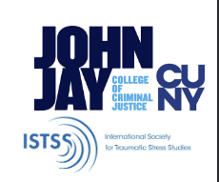
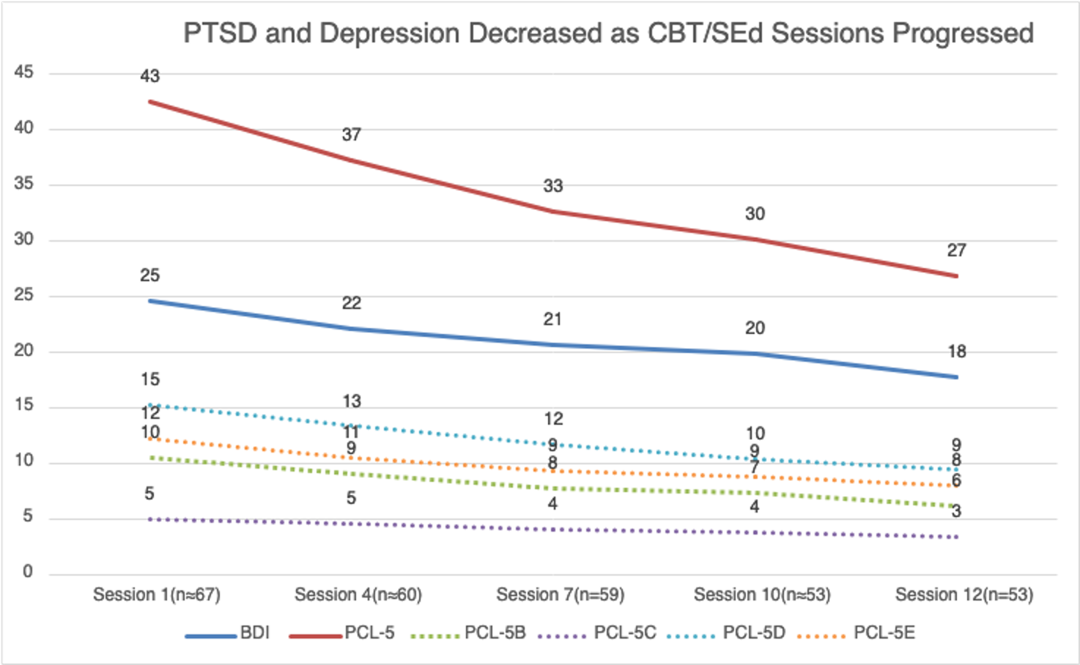
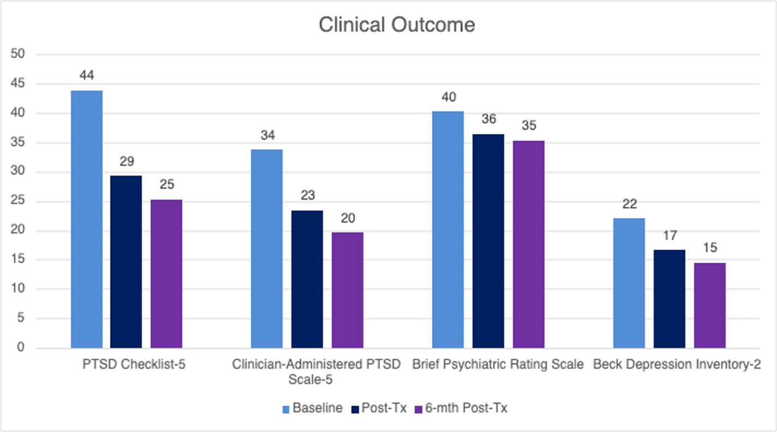
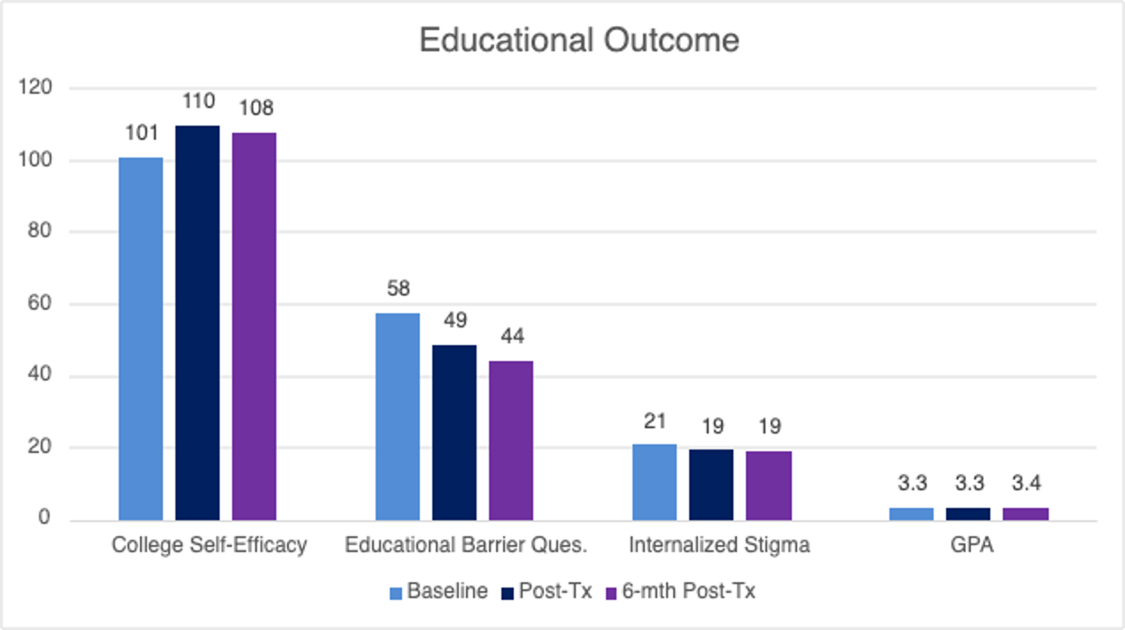
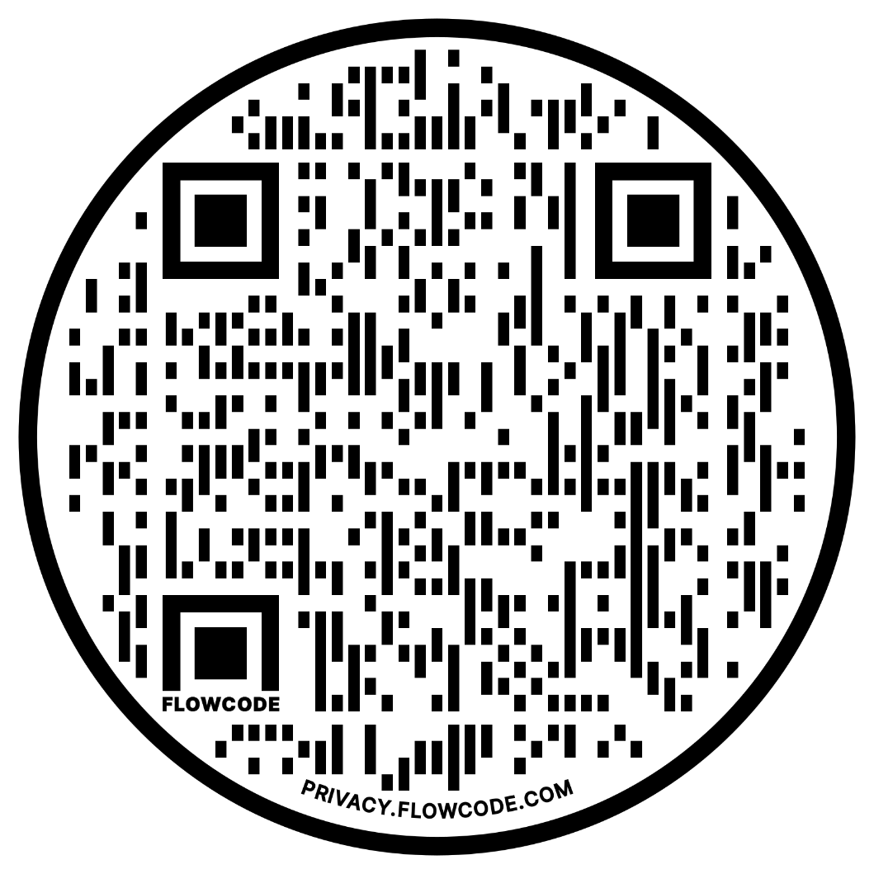
Preliminary Insight for Integrated Cognitive Behavior Treatment (CBT) and Supported Education (SEd) Initiative for Addressing Educational Challenges among Post-Secondary Education (PSE) Students with PTSD
Funded by: NIDILRR #90IFRE0038; Presented at Military Health System Research Symposium (MHSRS), August 2025, Orlando, FL
Weili Lu, Yuan Yao, Katrina Heller, Krista Rogers, Kiana Paniagua, Marina Redlich, Chloe Chong, Brittany Stone, Amy Banko, Giovanna Giacobbe, Sydney Tulloch, Chandni Suresh, Jiwoo Choi, William Waynor, Phil Yanos
RESULTS
Among 71 post-secondary students with PTSD undergoing CBT-SEd intervention, the majority completed sessions, with 81% finishing at least 6 sessions and 60% completing all 12 sessions.
Post-treatment and 6-month assessments revealed significant reductions in PTSD and depressive symptoms, with moderate to large effect sizes.
Internalized stigma decreased at post-treatment and 6-month follow-up, with moderate effect sizes.
Perceived barriers to education significantly decreased post-treatment, and treatment gains were maintained at the 6-month follow-up. Meanwhile, self-efficacy regarding completing college and GPA significantly improved.
DISCUSSION
Preliminary findings support the potential for the integrated CBT for PTSD intervention infused with Supported Education principles to manage PTSD symptoms and improve educational functioning in PSE students with PTSD. Findings have implications for ways to support veterans returning to post-secondary education.
SELECTED REFERENCES
Preliminary Findings on CBT-SEd for Students with PTSD
PTSD and Depression Decreased as CBD-SEd Sessions Progressed
INTRODUCTION
Post Traumatic Stress Disorder (PTSD) and its impact on post-secondary education (PSE) have rarely been examined. The study presents preliminary findings on an integrated Cognitive Behavior Treatment (CBT) and Supported Education (SEd) program to improve educational functioning among PSE students with PTSD.
METHOD
A total of 71 PSE students diagnosed with PTSD (11% cisgender male, 75% cisgender female, 3% transgender male, 6% other, 6% missing; 40% white vs. 60% non-white; 69% undergraduate vs. 23% graduate/med/law students), various assessments were conducted, including surveys on PTSD checklist for DSM5 (PCL-5), Clinician-Administered PTSD Scale (CAPS-5), Beck Depression Inventory (BDI-II), Brief Psychiatric Rating Scale, Internalized Stigma of Mental Illness (ISMI), Posttraumatic Cognitions Inventory, and educational outcomes such as College Self-Efficacy Scale, Educational Barriers Scale, and GPA.
The study examined their experiences before, after, and six months post-intervention. The 12-week intervention, CBT-SEd for PTSD, integrates individual Cognitive Behavioral Treatment (CBT) methods proven effective in randomized controlled trials (RCTs) and open trials along with a Supported Education (SEd) intervention developed collaboratively with input from individuals with lived experiences.
Baseline vs. Post CBT-SEd vs. 6-mth Post Treatment Clinical and Educational Outcomes (Means; N=58)
P < .05, Cohen’s d > 0.70
P < .05, Cohen's d < 0.70
Notes:
This is an AP-LS mod of Mike Morrison’s Better Poster. Keep what works for you. Change what doesn’t.
His tips:
Keep font size as high above 28+ as possible.
Keep your summary tight. Think of it like “abstract+” with key figures only.
The more content you add here, the more cognitive load you add, and the more you’ll turn people off engaging.
Less content = more readers.
Now delete this text box. ☺

