Slide 1
Approximating Facility Location and Activation Edge Cover problems
Zeev Nutov, The Open University of Israel
Joint work with: Guy Kortsarz & Eli Shalom

Slide 2
Facility Location
Given:
set $S$ of facilities , set $R$ of clients
weights $\{w_{s}:s∈S\}$ (opening costs)
costs $\{c_{e}:e∈E\}$ (service/connection costs)
Find: $A⊆S$ to minimize $w\left(A\right)+\sum_{r∈R}{c(r,A)}$
value = 5+4=9
value = 2+8=10
2
3
$$S$$
1
2
3
1
4
5
$$R$$

Slide 3
Facility Location – graph formulation
Given:
bipartite graph $G=\left(S+R,E\right)$
node weights $\left\{w_{s}:s∈S\right\}$
edge costs $\left\{c_{e}:e∈E\right\}$
Find: edge-cover of $R=$ a set $Λ$ of stars that covers R
to minimize $w\left(Λ\right)+c\left(Λ\right)$
$$w\left(Λ\right)=5$$
2
3
$$S$$
$$c\left(Λ\right)=4$$
1
2
3
1
4
5
$$R$$

Slide 4
Approximability
Costs = 0 $⟹$Weighted Set-Cover approximation threshold $Ω\left(\ln\left|R\right|\right)$
Approximation ratio $1+ln⁡\left|R\right|$ (Submodular Cover)
End of talk . . .
Questions?
Metric costs: ratio 1.488 [Li 11]
threshold 1.466 [Guha & Khuller 99]
gap=0.022

Slide 5
Teaser …
In many scenarios the costs are: not metric, not 0.
What ratio can we expect (in the non metric case) when: weights ≤ 1000, costs ≥ 1?
1000
500
$$S$$
1
2
5
3
1
4
1+ln|R|
1+ln(1001) ≈ 8
ln(1000)-lnln(1000) ≈ 5
$$R$$

Slide 6
Slope based approximation ratio
$$θ=\max_{r∈R,s∈S}{\frac{w_{s}}{c_{rs}}}$$
Slope of a FL instance:
1000
500
$$θ=\frac{1000}{2}=\frac{500}{1}$$
$$θ=\frac{1000}{1}=1000$$
1
2
2
5
3
1
4
$$\overline{ω}\left(θ\right)=\max_{k∈ℕ}{\frac{H_{k}−1}{1+k/θ}} ω\left(θ\right)=\max_{y≥1 }{\frac{\ln{y}}{1+y/θ}}$$
Fact: $\overline{ω}\left(θ\right)≤ω\left(θ\right)≈\ln{θ}−\ln{\ln{θ}}−1$

Slide 7
Slope based approximation ratio
10⁶ | 1000 | 100 | 5 | 1 | $$θ$$
11.47 | 5.422 | 3.636 | 1.815 | 1.279 | $$1+ω\left(θ\right)$$
11.09 | 5.081 | 3.343 | 1.664 | 1.217 | $$1+\overline{ω}\left(θ\right)$$
11.19 | 4.976 | 3.078 | 1.134 | - | $$\ln{θ}−\ln{\ln{θ}}$$
14.82 | 7.909 | 5.616 | 2.800 | 1.700 | $$1+\ln\left(θ+1\right)$$
Facility Location admits approximation ratios:
$1+ω\left(θ\right)$ for arbitrary costs
$1+\overline{ω}\left(θ\right)$ for locally uniform costs
each facility has
uniform service costs

Slide 8
Ratio $1+\overline{ω}\left(θ\right)$ for locally uniform costs
1000
500
$$θ=250$$
$$1+\overline{ω}\left(250\right)≈4$$
4
3
4
3
4
$$1+\overline{ω}\left(θ\right)=\max_{k∈ℕ}{\frac{θH_{k}+k}{θ+k}}$$
Facility Location: Find a set $Λ$ of stars that covers R,
minimize: $w\left(Λ\right)+c\left(Λ\right)$

Slide 9
Algorithm for locally uniform costs
$$Λ←∅$$
While $R$ is not covered
- add to $Λ$ a star of lowest average price
- remove from $G$ the leaves of the star added
$$w$$
$$s$$
= $\frac{w+kc}{k}=\frac{w}{k}+c$
average price of
$$c$$
$$c$$
$$c$$
$$c$$
...
...
$$k$$
$k$-1
$$i$$
1

Slide 10
Approximation ratio
consider a star of some optimal solution and its leaves $\left(k,…,1\right)$covered in this order ($k$ first, 1 last)
optimum pays for the star: $w+kc$
algorithm pays for leaf $i$ at most
the avg. price $≤\frac{w+ic}{i}=\frac{w}{i}+c$
algorithm pays for the star:
$wH_{k}+kc$
$$w$$
$$s$$
$$c$$
$$c$$
$$c$$
$$c$$
...
...
$$k$$
$k$-1
$$i$$
1
Thus the ratio is bounded by
$$\frac{wH_{k}+kc}{w+kc}=\frac{w/c⋅H_{k}+k}{w/c+k}≤\max_{k∈ℕ}{\frac{θH_{k}+k}{θ+k}}=1+\overline{ω}\left(θ\right)$$

Slide 11
Generalized Min-Covering problem
Given:
ground-set $Λ$
sub-additive set function $τ$ (payment)
decreasing set function $ν$ (potential)
Find: $A⊆Λ$ to minimize $τ\left(A\right)+ν\left(A\right)$
Interpretation:
$τ\left(A\right)$ = value of a partial solution A
$ν\left(A\right)$ = value of a “simple” solution for the residual problem
$τ\left(A\right)+ν\left(A\right)$= total value of the solution

Slide 12
Example: Set-Cover
$Λ=$ the given family of sets
$τ\left(A\right)=\left|A\right|$
$ν\left(A\right)=\left|{R∖R}_{A}\right|$, where $R_{A}=\bigcup_{s∈A}{s}$ is the set of elements covered by the sets in A
…
…
$$A$$
…
…
$$R_{A}$$
Any $A⊆Λ$ gives a feasible solution of size $τ\left(A\right)+ν\left(A\right)$

Slide 13
Example: Weighted Set-Cover
$Λ=$ the given family of sets
$τ\left(A\right)=w\left(A\right)$
$ν\left(A\right)=M\left(R∖R_{A}\right)$, where $M\left(v\right)$ is the minimum weight of a set that covers $v$
min-weight set
that covers $v$
…
…
$$A$$
…
…
$$v$$
$$R_{A}$$
Any $A⊆Λ$ gives a feasible solution of weight $τ\left(A\right)+ν\left(A\right)$

Slide 14
Relative Greedy Heuristic (RGH)
loss $≤$ gain
$$A←∅$$
while there exists an augmenting set of density $≤1$ do
add to $A$ a minimum density augmenting set $B$
return $A$
density of B w.r.t. A $=\frac{τ\left(B\right)}{ν\left(A\right)−ν\left(A∪B\right)}=$
average price B pays for a potential unit
The computed solution is composed from the parts – it is the union of the augmenting sets $B_{1},B_{2},…$ added during the algorithm.

Slide 15
Relative Greedy Heuristic - analysis
Let $A^{∗}$ be some optimal solution.
Denote: $τ^{∗}=τ\left(A^{∗}\right)$ $ν^{∗}=ν\left(A^{∗}\right)$ $opt=τ^{∗}+ν^{∗}$
$A_{i}=$ partial solution at the end of iteration $i$, $A_{0}=∅$
$ν_{i}=ν\left(A_{i}\right)$
$B_{i}=A_{i}∖A_{i−1}$ augmenting set added at iteration $i$
Since $B_{i}$ has minimum density and $density\left(B_{i}\right)≤1$
$$\frac{τ\left(B_{i}\right)}{ν_{i−1}−ν_{i}}≤\min\left\{1,\frac{τ^{∗}}{ν_{i−1}−ν^{∗}}\right\}$$
$$τ\left(B_{i}\right)≤\min\left\{1,\frac{τ^{∗}}{ν_{i−1}−ν^{∗}}\right\}\left(ν_{i−1}−ν_{i}\right)$$
density of $A^{∗}$

Slide 16
Relative Greedy Heuristic - analysis
$$\sum_{i=1}^{ℓ}{τ\left(B_{i}\right)}≤\sum_{i=1}^{ℓ}{\min\left\{1,\frac{τ^{∗}}{ν_{i−1}−ν^{∗}}\right\}\left(ν_{i−1}−ν_{i}\right)}$$
This is the lower Darboux sum of the function
$f\left(ν\right)=\left\{\begin{matrix}1 & ν_{ℓ}≤ ν≤τ^{∗}+ν^{∗} \\ \frac{τ^{∗}}{ν−ν^{∗}} & τ^{∗}+ν^{∗}≤ν≤ν_{0} \end{matrix}\right.$
1
Thus $\sum_{i=1}^{ℓ}{τ\left(B_{i}\right)}≤$
$$ν^{∗} ν_{ℓ} opt { ν}_{0}$$
$$\int_{ν_{ℓ}}^{τ^{∗}+ν^{∗}}{1dν}+\int_{τ^{∗}+ν^{∗}}^{ν_{0}}{\frac{τ^{∗}}{ν−ν^{∗}}dν}=\underset{opt}{\underbrace{τ^{∗}+ν^{∗}}}−ν_{ℓ}+τ^{∗}\ln{\frac{ν_{0}−ν^{∗}}{τ^{∗}}}$$

Slide 17
Relative Greedy Heuristic - performance
We proved
$$τ\left(A_{ℓ}\right)≤\sum_{i=1}^{ℓ}{τ\left(B_{i}\right)}≤opt−ν_{ℓ}+τ^{∗}\ln{\frac{ν_{0}−ν^{∗}}{τ^{∗}}}$$
subadditivity
Thus
$$\underset{solution value}{\underbrace{τ\left(A_{ℓ}\right)+ν\left(A_{ℓ}\right)}}≤opt+τ^{∗}\ln{\frac{ν_{0}−ν^{∗}}{τ^{∗}}}$$
Theorem: Relative Greedy Heuristic achieves ratio
$$1+\frac{τ^{∗}}{opt}\ln{\frac{ν_{0}−ν^{∗}}{τ^{∗}}}=1+\frac{τ^{∗}}{opt}\ln\left(1+\frac{ν_{0}−opt}{τ^{∗}}\right)$$
$$ν_{0}−ν^{∗}=τ^{∗}+ν_{0}−opt$$

Slide 18
Relative Greedy Heuristic - intuition
If $ν^{∗}=0$ then $τ^{∗}=opt$; then RGH ratio is bounded by
$$1+\frac{τ^{∗}}{opt}\ln{\frac{ν_{0}−ν^{∗}}{τ^{∗}}}=1+\ln\left(\frac{ν_{0}}{opt}\right)$$
We start with some “simple” $α$-approximate solution of value $ν_{0}=ν\left(∅\right)≤α⋅opt$.
At the end we get a solution of value $\left(1+\ln{α}\right)opt$.
So, RGH “converts” an $α$-approximate solution into a $\left(1+\ln{α}\right)$-approximate solution (if min-density augmenting sets can be found in polynomial time …).
In some cases, clever choices of the potential $ν$ enable to achieve a better ratio.

Slide 19
Ratio $ω\left(θ\right)$ for Facility Location
Given a Facility Location instance, for a client r define:
$M\left(r\right)=\min_{s∈S}\left(c_{rs}+w_{s}\right)$ (cheapest cover of r)
$m\left(r\right)=\min_{s∈S}{c_{rs}}$ (cheapest connection of r)
Define a Generalized Min-Covering instance
$Λ=$ collection of all stars
$τ\left(A\right)=w\left(A\right)+c\left(A\right)$
$ν\left(A\right)= M\left({R∖R}_{A}\right)$
$$− m\left(R_{A}\right)$$
$$+ m\left(R_{A}\right)$$
Any $A⊆Λ$ gives a feasible solution of value
$$τ\left(A\right)+ν\left(A\right)=w\left(A\right)+c\left(A\right)+M\left({R∖R}_{A}\right)$$

Slide 20
Ratio $ω\left(θ\right)$ for Facility Location-cont.
Lemma 1: There exists an optimal solution $A^{∗}$ such that
$${ R}_{A^{∗}}=R ⟹ ν^{∗}=ν\left(A^{∗}\right)=m\left(R\right)$$
Lemma 2: Denote $x=\frac{opt}{τ^{∗}}−1$. Then
$$θx≥1 and \frac{ν_{0}}{τ^{∗}}≤\left(θ+1\right)x$$
Substituting these bounds in the RGH ratio gives
$$1+\frac{τ^{∗}}{opt}\ln\left(1+\frac{ν_{0}−opt}{τ^{∗}}\right)≤1+\max_{θx≥1}\frac{ln\left(θx\right)}{x+1}=1+ω\left(θ\right)$$
$$y=θx$$

Slide 21
Edge Cover problems
Given:
graph $G=\left(V,E\right)$
set of terminals $R⊆V$
payment function over the edges
Goal: Find a cheapest edge cover of R.
edge cover of R = edge set $J$ such that $R⊆endnodes\left(J\right)$
= a set of stars that contains R
payment = cost of the edges: the classic Edge Cover problem, solvable in polynomial time [Edmonds 65]
payment = weight of the endnodes: Weighted Set Cover, NP-hard, admits approximation ratio $H_{\left|R\right|}.$

Slide 22
Activation Edge Cover [Panigrahi 11]
2
5
Given:
multigraph $G=\left(V,E\right)$
set of terminals $R⊆V$
thresholds $\left\{t_{u}^{e},t_{v}^{e}\right\}$ for each $e=uv∈E$
$$u$$
$$v$$
7
1
Goal: Assign values $\left\{a_{v}:v∈V\right\}$ to the nodes such that the edge set $\left\{e=uv∈E:{a_{u}≥t}_{u}^{e},a_{v}≥t_{v}^{e}\right\}$ activated by the assignment covers R; minimize $\sum_{v∈V}{a_{v} }$.
Facility Location is a particular case when $G=\left(S+R,E\right)$ is bipartite and${ t}_{r}^{e}=c_{rs},t_{s}^{e}=w_{s}$ for each $e=rs∈E$.
With appropriate definition of $θ$ our result extends to Activation Edge Cover problems.

Slide 23
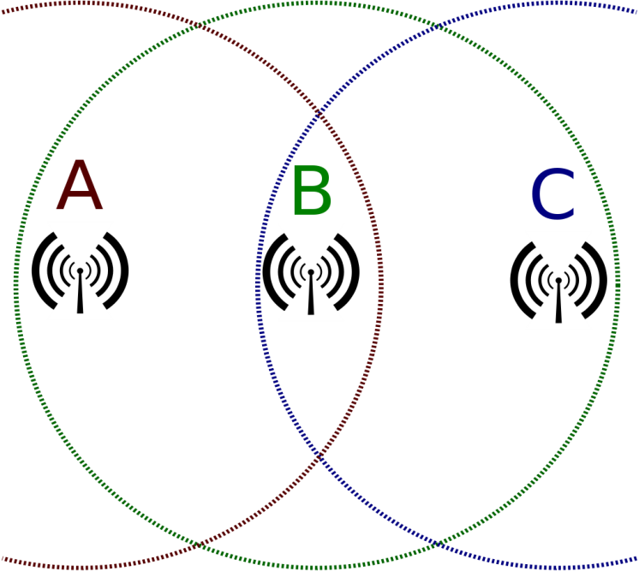
Example 1: Min-Power problems
Nodes in the network are transmitters.
Every node connects to all nodes in its range.
More power ⇒ larger transmission range.
Transmission range is a disk centered at the node.
We want to assign energy levels to the nodes such that the resulting communication network satisfies a given property, and the total energy is minimal.

Slide 24
Min-Power problems- Illustration
d
e
d
e
c
c
b
f
b
f
a
a
Directed
Range assignment
Communication network
Undirected
d
e
c
b
f
a

Slide 25
Min-Power Edge-Cover
Given:
graph $G=\left(V,E\right),$set of terminals $R⊆V$
power threshold $p_{e}$ for each $e=uv∈E$
Goal: Assign values $\left\{a_{v}:v∈V\right\}$ to the nodes such that the edge set $\left\{e=uv∈E:a_{u}≥p_{u},a_{v}≥p_{v}\right\}$ activated by the assignment covers R; minimize $\sum_{v∈V}{a_{v} }$.
This is a particular case of Activation Edge-Cover when ${ t}_{u}^{e} =t_{v}^{e}=p_{e}$ for every edge $e=uv∈E$.
Here $θ=1$, so we get ratio $1+ω\left(1\right)≈1.28$.
The previous ratio was 1.41 [CKN 18].
Better ratio 1.22 is known for bipartite graphs [CKN 18].

Slide 26
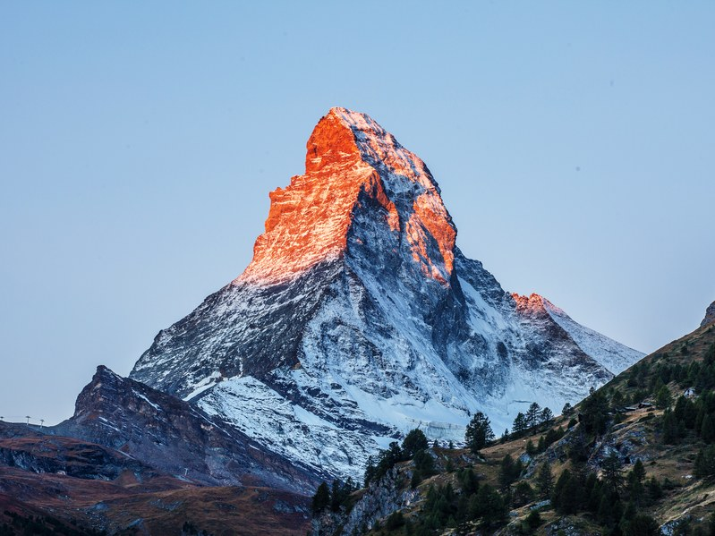
Example 2: Tower Installation
Installation cost of a wireless network is proportional to the total height of the antenna towers.
Towers should be tall enough to overcome obstructions and establish line of sight between the antennas.

Slide 27
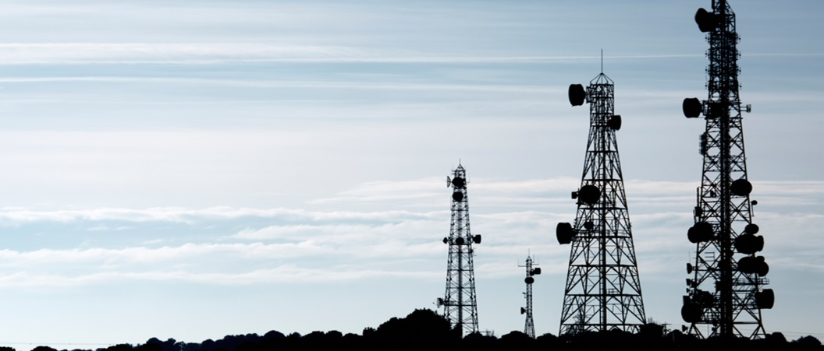
Tower Installation Edge-Cover
We need to assign heights to the antennas such that each terminal can communicate with some other node, while minimizing the total sum of the heights.
The maximum tower height over the minimum tower height is usually bounded by a constant.
If possible tower heights are 4,15,20 then the slope is $θ=5$; then our result gives ratio $1+ω\left(5\right)<1.82$.

Slide 28
Conclusions
RGH is a great tool (!) to convert ratio $α$into $1+\ln{α}$ (provided that…).
RGH was used for the Steiner Tree problem, by Zelikovsky, and Robins & Zelikovsky; our proof follows the survey of Gröpl, Hougardy, Nierhoff, & Prömel.
Explicit formulation of the Generalized Min-Covering problem and the applications given here, are new.
Our approach gives a unifying and simpler description and analysis of approximation algorithms for the Steiner Tree problem; e.g., of the “Loss Contraction Algorithm” of Robins & Zelikovsky.

Slide 29
Open Problems
For the Facility Location problem, no “good” slope based approximation hardness results are known.
There are several ways to define the “coverage” and the “partial cover” version of these problems. This is currently a work in progress.
[Slavik 96] showed that the greedy algorithm for Set-Cover has ratio $\ln{n}−\ln{\ln{n}+O\left(1\right)}$; our slope based ratio for FL is $\ln{θ}−\ln{\ln{θ}+O\left(1\right)}$. The connection between these two results is not clear.

Slide 30
Thank you for attention!
Questions?

