Slide 1
Approximation Algorithms for Non-Uniform Buy-at-Bulk Network Design Problems
Guy Kortsarz
Rutgers University, Camden, NJ
Joint work with
C. Chekuri (Bell Labs)
M.T. Hajiaghayi (CMU)
M. R. Salavatipour (University of Alberta)

Slide 2
Motivation
Suppose we are given a network and some nodes have to be connected by cables
Each cable has a cost
(installation or cost of
usage)
Question: Install cables
satisfying demands at
minimum cost
10
5
3
21
9
7
11
14
8
16
21
27
12
This is the well-studied Steiner forest problem and is
NP-hard

Slide 3
Motivation (cont’d)
Consider buying bandwidth to meet demands between pairs of nodes.
The cost of buying bandwidth satisfy economies of scale
The capacity on a link can be purchased at discrete units:
Costs will be:
Where

Slide 4
Motivation (cont’d)
So if you buy at bulk you save
More generally, we have a non-decreasing monotone concave function where f (b) is the minimum cost of cables with bandwidth b.
Question: Given a set of bandwidth demands between nodes, install sufficient capacities at minimum cost
cost
bandwidth

Slide 5
Motivation (cont’d)
The previous problem is equivalent to the following problem:
There are a set of pairs
to be connected
For each possible cable connection e we can:
Buy it at b(e): and have unlimited use
Rent it at r(e): and pay for each unit of flow
A feasible solution: buy and/or rent some edges to connect every s_{i} to t_{i}.
Goal: minimize the total cost

Slide 6
Motivation (cont’d)
If this edge is bought its contribution to total cost is 14.
10
14
If this edge is rented, its contribution to total cost is 2x3=6
3
Total cost is:
where f(e) is the number of paths going over e.

Slide 7
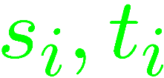
Cost-Distance
These problems are also known as cost-distance problems:
cost function
length function
Also a set of pairs of nodes each with a demand for every i
Feasible solution: a set s.t. all pairs
are connected in

Slide 8
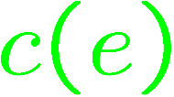
Cost-Distance (cont’d)
The cost of the solution is:
where is the shortest path in
The cost is the start-up cost and
is the per-use cost (length).
Goal: minimize total cost.

Slide 9
Multicommodity Buy At Bulk
Note that the solution may have cycles
The problem is called
Multi-Commodity Buy-at-Bulk (MC-BB)
5
11
8
12
21

Slide 10
Special Cases
If all s_{i} (sources) are equal we have the single-source case (SS-BB)
Single-source
If the cost and length
functions on the edges
are all the same, i.e.
each edge e has cost
c + l⋅ f(e) for constants
c,l : Uniform-case
5
12
21
8
11

Slide 11
Previous Work
Formally introduced by F. S. Salman, J. Cheriyan, R. Ravi and S. Subramanian, 1997
O(log n) approximation for the uniform case, i.e. each edge e has cost c+l⋅f(e) for some fixed constants c, l (B. Awerbuch and Y. Azar, 1997; Y. Bartal, 1998)
O(log n) randomized approximation for the single-sink case: A. Meyerson, K. Munagala and S. Plotkin, 2000
O(log n) deterministic approximation for the single-sink case: C. Chandra, S. Khanna and S. Naor, 2001

Slide 12
Hardness Results for Buy-at-Bulk Problems
Hardness of Ω(log log n) for the single- sink case J. Chuzhoy, A. Gupta, J. Naor and A. Sinha, 2005
Ω(log^{1/2-ε} n) in general Andrews 2004, unless NP⊆ ZPTIME(n^{polylog(n)})

Slide 13
Algorithms for Special Cases
Steiner Forest
A. Agrawal, P. Klein and R. Ravi, 1991
M. X. Goemans and D. P. Williamson, 1995
Single source
S. Guha, A. Meyerson and K. Munagala , 2001
K. Talwar, 2002
A. Gupta, A. Kumar and T. Roughgarden, 2002
A. Goel and D. Estrin, 2003

Slide 14
Multicommodity Buy at Bulk
Multicommodity Uniform Case:
Y. Azar and B. Awerbuch, 1997
Y. Bartal,1998
A. Gupta, A. Kumar, M. Pal and T. Roughgarden, 2003
The only known approximation for the general case
M. Charikar, A. Karagiozova, 2005. The ratio is:
exp( O(( log n log log n )^{1/2} ))⋅log D

Slide 15
Our Main Result
Theorem: If D denotes the largest demand d_{i} and h is the number of pairs of s_{i},t_{i} then there is a polytime algorithm with approximation ratio O(min{log³h⋅ log D, log⁵ h⋅ loglog h}).
Corollary: If every demand d_{i} is polynomial in n the approximation ratio is at most O(log⁴ n) and for arbitrary demands the approximation ratio is O(log⁵n ⋅ loglog n).
For simplicity we focus on the unit-demand case (i.e. d_{i}=1 for all i’s)

Slide 16
Recent Development
Racke showed how to generalize our junction tree lemma (see later) to exponential demands
As a result we can prove:
O (log⁴n) - ratio approximation algorithm
even if the demands are
super-polynomial in n.

Slide 17
Overview of the Algorithm
The algorithm iteratively finds a partial solution connecting some of the residual pairs
The new pairs are then removed from the set; repeat until all pairs are connected (routed)
Density of a partial solution =
cost of the partial solution
# of new pairs routed
The algorithm tries to find low density partial solution at each iteration

Slide 18
Overview of the Algorithm (cont’d)
The density of each partial solution is at most
O(log³ n) ⋅ (OPT / h') where OPT is the cost of optimum solution and h' is the number of unrouted pairs
A simple analysis (like for set cover) shows:
Total Cost
≤ O(log³ n) ⋅ OPT ⋅ (1/n² + 1/(n² - 1) +…+ 1)
≤ O(log⁴ n) ⋅ OPT

Slide 19
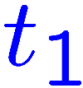
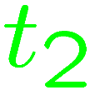
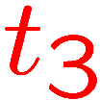
Structure of the Optimum
How to compute a low-density partial solution?
Prove the existence of low-density one with a very specific structure: junction-tree
Junction-tree: given a set P of pairs, tree T rooted at r is a junction tree if
It contains all pairs of P
For every pair s_{i},t_{i}∈ P the
path connecting them
in T goes through r
r

Slide 20
Structure of the Optimum (cont’d)
So the pairs in a junction tree connect via the root
We show there is always a partial solution with low density that is a junction tree
Observation: If we know the pairs participating in a junction-tree it reduces to the single-source BB problem
r
Then we could use the O(log n) approximation of [MMP’00]

Slide 21
Summary of the Algorithm
So there are two main ingredients in the proof
Theorem 2: There is always a partial solution that is a junction tree with density O (log n) ⋅ (OPT / h')
Theorem 3: There is an approximation for the problem of finding lowest density junction tree (this is low density SS-BB).
Corollary: We can find a partial solution with density O (log³ n) ⋅ (OPT / h')
This implies an approximation for MC-BB.

Slide 22
More Details of the Proof of Theorem 2:
We want to show there is a partial solution that is a junction tree with density O (log n) ⋅ (OPT / h')
Consider an optimum solution OPT.
Let E* be the edge set of OPT, be its cost and
its length.
Let be the average length of pairs in the OPT.
We prove that we can decompose OPT into vertex-disjoint graphs with certain properties.

Slide 23
More Details of the Proof of Theorem 2:
Let be the edge-set of
satisfy the following:
Each routes a disjoint set of pairs and
The diameter of each is at most Δ = 2log n ⋅ L
The distance between every pair in each is at most 2L
Each has low density: c(E_{i}) / |T_{i}| ≤ 8⋅opt_{c}/h
We take a tree rooted at a terminal
Each tree is a shortest-path tree.

Slide 24
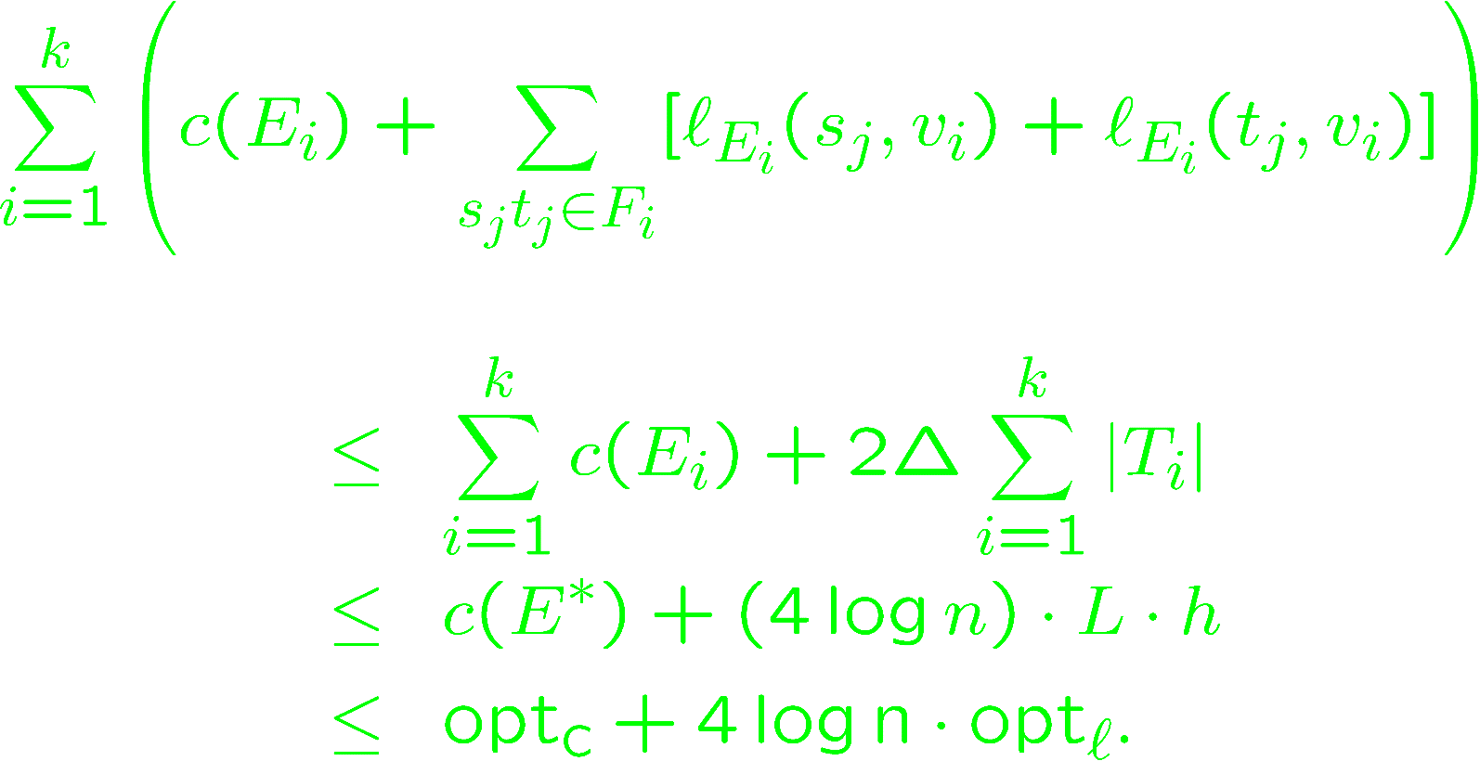
More Details of the Proof of Theorem 2:
By diameter bound, distance of every node to in is at most Δ = 2log n ⋅ L
The total cost of these trees is at most:

Slide 25
More Details of the Proof of Theorem 2:
Since there are at least pairs in the trees, one of them has density at most
This shows there is a junction-tree with density at most
To prove the existence of decomp
we use a region growing procedure.

Slide 26
Decomposing OPT
Each increase of L in the radios, touching paths become internal paths
t₃
s₁
t₂
s₂
t₁
t₄
s₄
s₃

Slide 27
Some Details of the Proof of Theorem 3:
Theorem 3: There is an approximation for finding lowest density junction tree.
This is very similar to SS-BB except that we have to find a lowest density solution.
Here we have to connect a subset of the pairs to the root v with lowest density
(= cost of solution / # of pairs in sol).
Let denote the set of paths from s to t_{i}.
We formulate the problem as an IP and then consider the LP relaxation of the problem

Slide 28
Some Details of the Proof of Theorem 3:
We solve the LP, and then based on the solution find a subset of nodes to solve the SS-BB on.
We use the approx of [MMP 2000,CKN 2001] for SS-BB
We loose another factor in the process of reduction to SS-BB (details omitted)

Slide 29
Some Remarks:
For the polynomially bounded demand case we can find low density junction-trees using a greedy algorithm
The greedy algorithm is based on an algorithm for the k shallow-light tree problem
For arbitrary demands, we use the upper bound
of M. Elkin, Y. Emek, D. Spielman, S. Teng, (2005)
(which is O (log²n ⋅ loglog n)) for distortion in embedding a graph metric into a probability distribution over its spanning trees.

Slide 30
Some Remarks (cont’d):
This is why we get a factor of for approximation factor comparing to O (log⁵n ⋅ loglog n))
for polynomially bounded demands.
There is a conjectured upper bound of
for distortion in embedding a graph metric into a probability distribution over its spanning tree (N. Alon, R. Karp, D. Peleg and D. West, 1991)
If true, that would improve our approximation factor for arbitrary demands to

Slide 31
Recent Developments
Racke: junction trees for exponential demands
We use it to get O (log⁴ n) ratio for the general case
Also, O (log⁴ n) ratio approximation for the case of vertex costs
Work in progress: O (log³ n) ratio approximation for MC-BB for polynomial demands

Slide 32
Related Problem
Given a graph with vertex costs vertex profits and budget B bound, find a maximum profit subtree of budget at most B
First algorithm: Guha, Moss, Rabani and Schieber.
2B cost, opt/O(log² n) profit
Improvement: Moss and Rabani.
2B cost, opt/O(log n) profit
Kortsarz, Nutov. B budget, opt/(O (log n )) profit
Not approximable within loglog n/4
Can handle adding lengths and bounding diameter

Slide 33
Discussion and Open Problems
There are still quite large gaps between upper bounds (approx alg) and lower bounds (hardness)
For MC-BB: vs
For SS-BB: vs
It would be nice to upper bound the integrality gap for MC-BB.
MCST: is it log n hard?

