Slide 1
On the Advantage of Overlapping Clustering for
Minimizing Conductance
Rohit Khandekar, Guy Kortsarz,
and Vahab Mirrokni

Slide 2
Outline
Problem Formulation and Motivations
Related Work
Our Results
Overlapping vs. Non-Overlapping Clustering
Approximation Algorithms

Slide 3
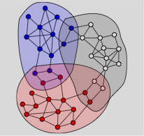
Overlapping Clustering: Motivations
Motivation:
  Natural Social Communities[MSST08,ABL10,…] →
  Better clusters (AGM)
  Easier to compute (GLMY)
  Useful for Distributed
  Computation (AGM)
Good Clusters → Low Conductance?
  Inside: Well-connected,
  Toward outside: Not so well-connected.

Slide 4
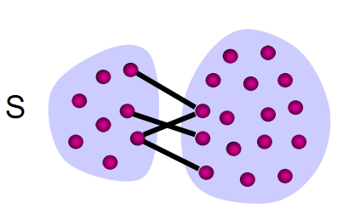
Conductance and Local Clustering
Conductance of a cluster S =
Approximation Algorithms
  O(log n)(LR) and (ARV)
Local Clustering: Given a node v,
find a min-conductance cluster S
containing v.
Local Algorithms based on
  Truncated Random Walk(ST03), PPR Vectors (ACL07)
  Empirical study: A cluster with good conductance (LLM10)

Slide 5
Overlapping Clustering: Problem Definition
Find a set of (at most K) overlapping clusters:
each cluster with volume <= B,
covering all nodes,
and minimize:
  Maximum conductance of clusters (Min-Max)
  Sum of the conductance of clusters (Min-Sum)
Overlapping vs. non-overlapping variants?

Slide 6
Overlapping Clustering: Previous Work
Natural Social Communities[Mishra, Schrieber, Santhon, Tarjan08, ABL10, AGSS12] →
Useful for Distributed Computation[AGM: Andersen, Gleich, Mirrokni]
Better clusters (AGM)
Easier to compute (GLMY)

Slide 7
Overlapping Clustering: Previous Work
Natural Social Communities[MSST08, ABL10, AGSS12] →
Useful for Distributed Computation (AGM)
Better clusters (AGM)
Easier to compute (GLMY)

Slide 8
Better and Easier Clustering: Practice
Previous Work: Practical Justification
Finding overlapping clusters for public graphs(Andersen, Gleich, M., ACM WSDM 2012)
  Ran on graphs with up to 8 million nodes.
  Compared with Metis and GRACLUS → Much better conductance.
  Clustering a Youtube video subgraph (Lu, Gargi, M., Yoon, ICWSM 2011)
  Clustered graphs with 120M nodes and 2B edges in 5 hours.
  https://sites.google.com/site/ytcommunity

Slide 9
Our Goal: Theoretical Study
Confirm theoretically that overlapping clustering is easier and can lead to better clusters?
Theoretical comparison of overlapping vs. non-overlapping clustering,
  e.g., approximability of the problems

Slide 10
Overlapping vs. Non-overlapping: Results
This Paper: [Khandekar, Kortsarz, M.]
Overlapping vs. no-overlapping Clustering:
  Min-Sum: Within a factor 2 using Uncrossing.
  Min-Max: Overalpping clustering might be much better.

Slide 11
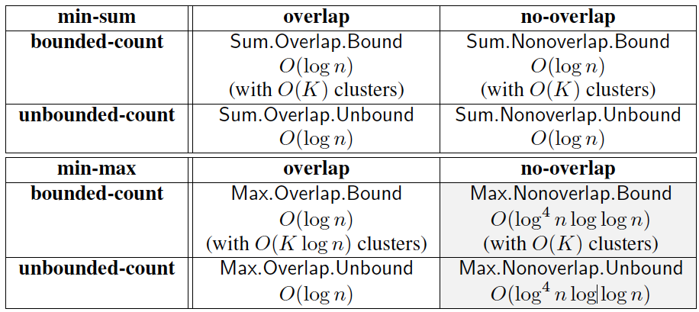
Overlapping Clustering is Easier
This Paper: [Khandekar, Kortsarz, M.]
Approximability →

Slide 12
Summary of Results
[Khandekar, Kortsarz, M.]
Overlap vs. no-overlap:
  Min-Sum: Within a factor 2 using Uncrossing.
  Min-Max: Might be arbitrarily different.

Slide 13
Overlap vs. no-overlap
Min-Sum: Overlap is within a factor 2 of no-overlap. This is done through uncrossing:

Slide 14
Overlap vs. no-overlap
Min-Sum: Overlap is within a factor 2 of no-overlap. This is done through uncrossing:
Min-Max: For a family of graphs, min-max solution is very different for overlap vs. no-overlap:
  For Overlap, it is .
  For no-overlap is .

Slide 15
Overlap vs. no-overlap: Min-Max
Min-Max: For some graphs, min-max conductance from overlap << no-overlap.
  For an integer k, let , where H is a 3-regular expander on nodes, and
  .
  Overlap: for each , , thus min-max conductance
  Non-overlap: Conductance of at least one cluster is at least , since H is an expander.

Slide 16
Max-Min Clustering: Basic Framework
  Racke: Embed the graph into a family of trees while preserving the cut values.
  Solve the problem using a greedy algorithm or dynamic program on trees
    Max-Min Clustering:
      A Greedy Algorithm works
      Use a simple dynamic program in each step
    Max-Min non-overlapping clustering:
      Need a complex dynamic program.

Slide 17
Tree Embedding
Racke: For any graph G(V,E), there exists an embedding of G to a convex combination of trees such that the value of each cut is preserved within a factor in expectation.
  We lose a approximation factor here.
Solve the problem on trees:
  Use a dynamic program on trees to implement steps of the algorithm

Slide 18
Max-Min Overlapping Clustering
Let t = 1.
Guess the value of optimal solution OPT
  i.e., try the following values for OPT: Vol(V (G))/ 2^{^i} for 0<i<log vol(V (G)).
Greedy Loop to find S₁,S₂,…,S_{t}: While union of clusters do not cover all nodes
  Find a subset S_{t} of V (G) with the conductance of at most OPT which maximizes the total weight of uncovered nodes.
    Implement this step using a simple dynamic program
  t := t + 1.
Output S₁,S₂,…,S_{t}.

Slide 19
Max-Min Non-Overlapping Clustering
Iteratively finding new clusters does not work anymore. We first design a Quasi-Poly-Time Alg:
We should guess OPT again,
Consider the decomposition of the tree into classes of subtrees with 2^{i} OPT conductance for each i, and guess the #of substrees of each class,
Design a complex quasi-poly-time dynamic program that verifies existence of such decomposition. Then…

Slide 20
Quasi-Poly-Time → Poly-Time
Observations needed for Quasi-poly-time → Poly-time
The depth of the tree T is O(log n), say a log n for some constant a > 0,
The number of classes can be reduced from O(log n) to O(log n/log log n) by defining class 0 to be the set of trees T with conductance(T) < (log n) OPT and class k to be set of trees T with (log n)^{k} OPT < Conductance(T) < (log n)^{k+1}OPT → Lose another log n factor here.
Carefully restrict the vectors considered in the dynamic program.
Main Conclusion: Poly-log approximation for Min-Max non-overlap is much harder than logarithmic approximation for overlap.

Slide 21
Min-Sum Clustering: Basic Idea
Min-Sum overlap and non-overlap are similar.
Reduce Min-Sum non-overlap to Balanced Partitioning:
  Since the number and volume of clusters is almost fixed (combining disjoint clusters up to volume B does not increase the objective function).
  Log(n)-approximation for balanced partitioning.

Slide 22
Summary Results
Overlap vs. no-overlap:
  Min-Sum: Within a factor 2 using Uncrossing.
  Min-Max: Might be arbitrarily different.

Slide 23
Local Graph Algorithms
Local Algorithms: Algorithms based on local message passing among nodes.
Local Algorithms:
Applicable in distributed large-scale graphs.
Faster, Simpler implementation (Mapreduce, Hadoop, Pregel).
Suitable for incremental computations.

Slide 24
Local Clustering: Recap
Conductance of a cluster S =
Goal: Given a node v, find a
min-conductance cluster S
containing v.
Local Algorithms based on
  Truncated Random Walk(ST), PPR Vectors (ACL), Evolving Set(AP)

Slide 25
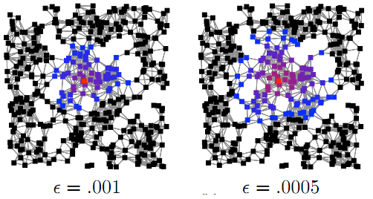
Approximate PPR vector
Personalized PageRank: Random Walk with Restart.
PPR Vector for u: vector of PPR value from u.
Contribution PR (CPR) vector for u: vector of PPR value to u.
Goal: Compute approximate PPR or CPR Vectors with an additive error of

Slide 26
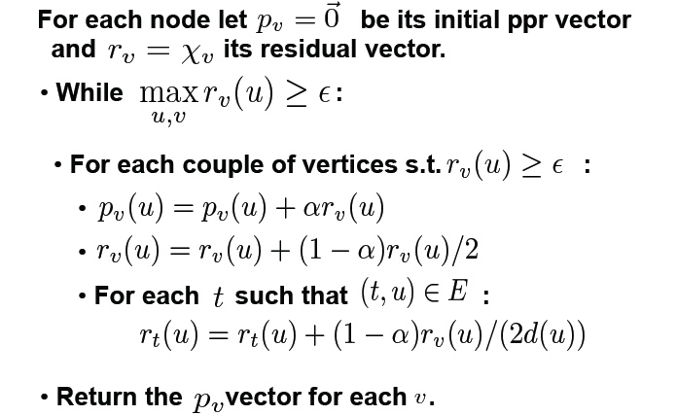
Local PushFlow Algorithms

Slide 27
Local Algorithms
Local PushFlow Algorithms for approximating both PPR and CPR vectors (ACL07,ABCHMT08)
Theoretical Guarantees in approximation:
  Running time: [ACL07]
  O(k) Push Operations to compute top PPR or CPR values [ABCHMT08]
Simple Pregel or Mapreduce Implementation

Slide 28
Full Personalized PR: Mapreduce
Example: 150M-node graph, with average outdegree of 250 (total of 37B edges).
11 iterations, , 3000 machines, 2G RAM each 2G disk → 1 hour.
with E. Carmi, L. Foschini, S. Lattanzi

Slide 29
PPR-based Local Clustering Algorithm
Compute approximate PPR vector for v.
Sweep(v): For each vertex v, find the min-conductance set among subsets
where ‘s are sorted in the decreasing order of .
Thm[ACL]:If the conductance of the output is , and the optimum is , then where k is the volume of the optimum.

Slide 30
Local Overlapping Clustering
Modified Algorithm:
  Find a seed set of nodes that are far from each other.
  Candidate Clusters: Find a cluster around each node using the local PPR-based algorithms.
  Solve a covering problem over candidate clusters.
  Post-process by combining/removing clusters.
Experiments:
  Large-scale Community Detection on Youtube graph (Gargi, Lu, M., Yoon).
  On public graphs (Andersen, Gleich, M.)

Slide 31
Large-scale Overlapping Clustering
  Clustering a Youtube video subgraph (Lu, Gargi, M., Yoon, ICWSM 2011)
  Clustered graphs with 120M nodes and 2B edges in 5 hours.
  https://sites.google.com/site/ytcommunity
Overlapping clusters for Distributed Computation (Andersen, Gleich, M.)
  Ran on graphs with up to 8 million nodes.
  Compared with Metis and GRACLUS → Much better quality.

Slide 32
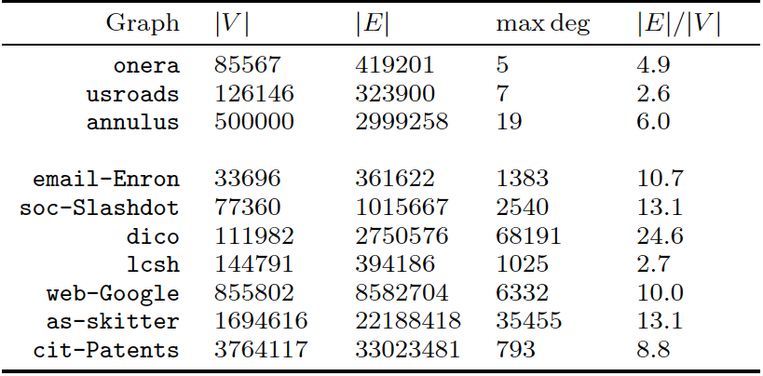
Experiments: Public Data

Slide 33
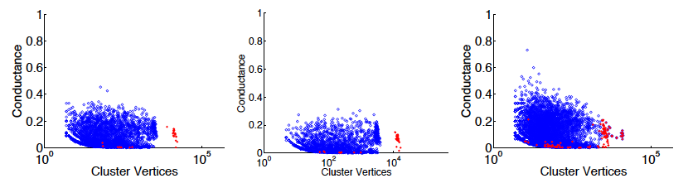
Average Conductance
Goal: get clusters with low conductance and volume up to 10% of total volume
Start from various sizes and combine.
  Small clusters: up to volume 1000
  Medium clusters: up to volume 10000
  Large Clusters: up to 10% of total volume.

Slide 34
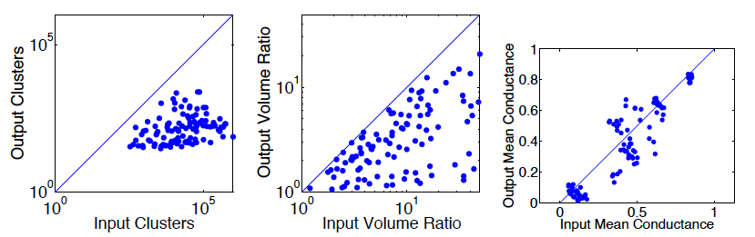
Impact of Heuristic: Combining Clusters

Slide 35
Ongoing/Future Large-scale clustering
Design practical algorithms for overlapping clustering with good theoretical guarantee
Overlapping clusters and G+ circles?
Local algorithm for low-rank embedding of large graphs → [Useful for online clustering]
  Message-passing-based low-rank matrix approximation
  Ran on a graph with 50M nodes and in 3 hours (using 1000 machines)
  With Keshavan, Thakur.

Slide 36
Outline
Overlapping Clustering:
Theory: Approximation Algorithms for Minimizing Conductance
Practice: Local Clustering and Large-scale Overlapping Clustering
Idea: Helping Distributed Computation

Slide 37
Clustering for Distributed Computation
Implement scalable distributed algorithms
  Partition the graph → assign clusters to machines
  must address communication among machines
  close nodes should go to the same machine
Idea: Overlapping clusters [Andersen, Gleich, M.]
Given a graph G, overlapping clustering (C, y) is
  a set of clusters C each with volume < B and
  a mapping from each node v to a home cluster y(v).
Message to an outside cluster for v goes to y(v).
  Communication: e.g PushFlow to outside clusters

Slide 38
Formal Metric: Swapping Probability
In a random walk on an overlapping clustering, the walk moves from cluster to cluster.
On leaving a cluster, it goes to the home cluster of the new node.
Swap: A transition between clusters
  requires a communication if the underlying graph is distributed.
Swapping Probability := probability of swap in a long random walk.

Slide 39
Swapping Probability: Lemmas
Lemma 1: Swapping Probability for Partitioning :
Lemma 2: Optimal swapping probability for overlapping clustering might be arbitrarily better than swapping partitioning.
  Cycles, Paths, Trees, etc

Slide 40

Lemma 2: Example
Consider cycle with nodes.
Partitioning: 2/B (M paths of volume B←Lemma 1)
Overlapping Clustering: Total volume:4n=4MB
  When the walk leaves a cluster, it goes to the center of another cluster.
  A random walk travels in t steps → it takes B^2/2 to leave a cluster after a swap.
  → Swapping Probability = 4/B^2.

Slide 41
Experiments: Setup
We empirically study this idea.
Used overlapping local clustering…
Compared with Metis and GRACLUS.

Slide 42
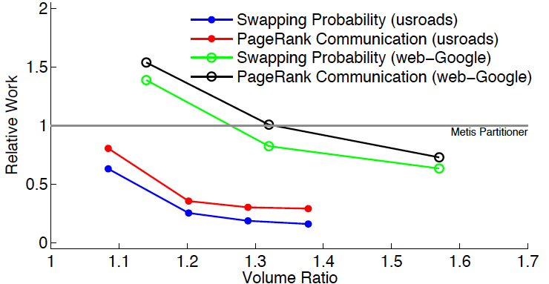
Swapping Probability and Communication

Slide 43
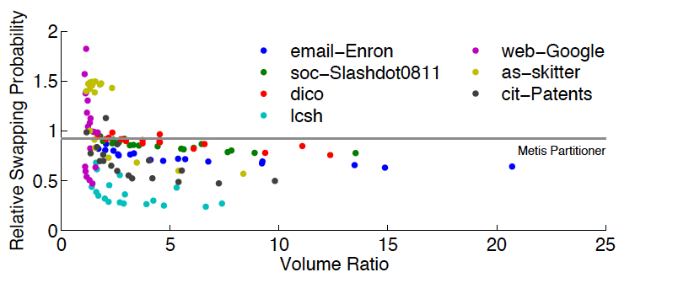
Swapping Probability

Slide 44
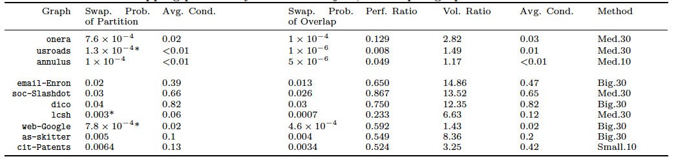
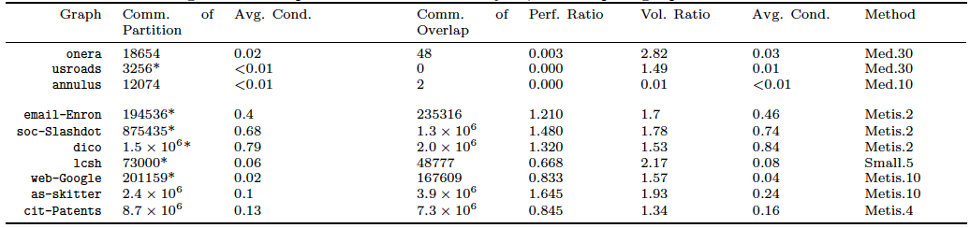
Swapping Probability, Conductance and Communication
Swapping Probability
Communication

Slide 45
A challenge and an idea
Challenge: To accelerate the distributed implementation of local algorithms, close nodes (clusters) should go to the same machine ← Chicken or Egg Problem.
Idea: Use Overlapping clusters:
  Simpler for preprocessing.
  Improve communication cost (Andersen, Gleich, M.)
Apply the idea iteratively?

Slide 46
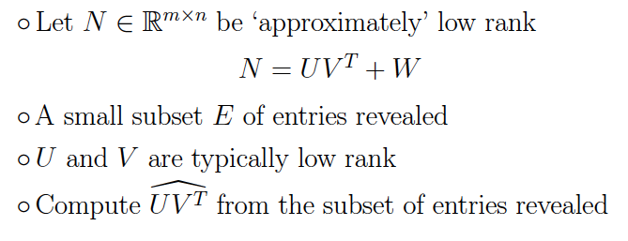
Message-Passing-based Embedding
  Pregel Implementation of Message-passing-based low-rank matrix approximation.
  Ran on G+ graph with 40 million nodes and used for friend suggestion: Better link prediction than PPR.

Slide 47
Open Problems
Practical algorithms with good theoretical guarantees?
Overlapping clustering for other clustering metrics, e.g., density, modularity?
How about Minimizing norms other than Sum and Max, e.g., L₂ or L_{p} norms?
Thank You!

