Slide 1
Matroid Secretary for Regular and Decomposable Matroids
Michael Dinitz
Guy Kortsarz
Weizmann Institute of Science
Johns Hopkins University
Rutgers University, Camden

Slide 2
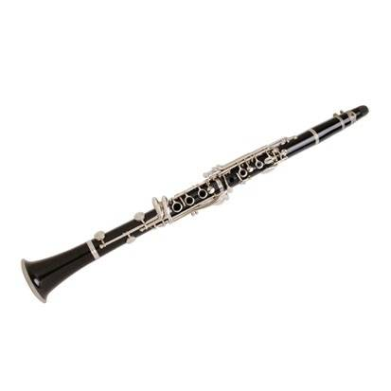
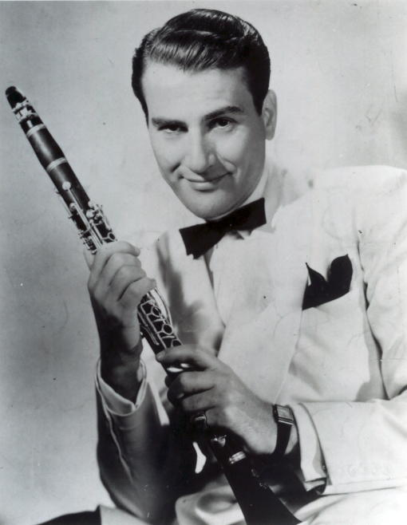
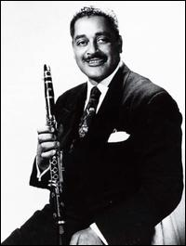
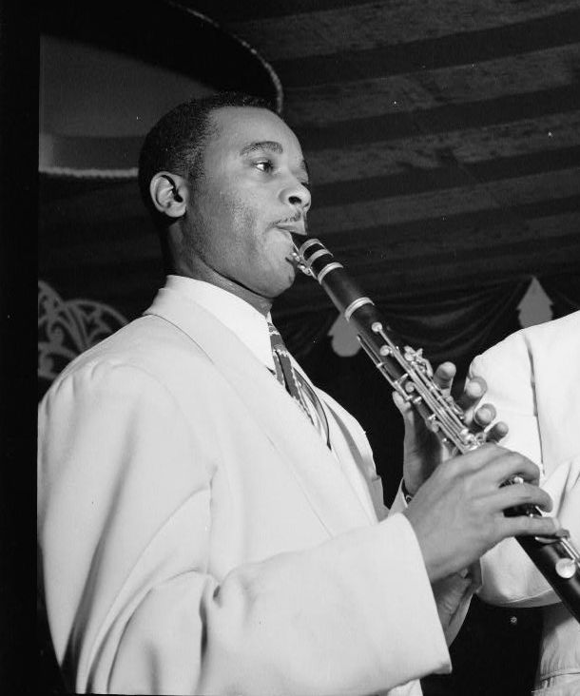
Secretary Problem: Basic
$5
$1000
$15
$2000
$200
Danny Polo
Artie Shaw
Buster Bailey
Mezz Mezzrow
Jimmy Hamilton

Slide 3
Classical Secretary
Goal: algorithm which gets (in expectation) value at least Ω(1) of OPT
c-competitive: OPT / E[ALG] ≤ c
Impossible if values and ordering adversarial
Classical setting: adversarial values, random order
Threshold Algorithm:
Let first 1/2 of bids go by, set threshold to highest value in sample
Select next bid larger than threshold

Slide 4
Secretary Problem: Basic
$5
$1000
$15
$2000
$200
Danny Polo
Artie Shaw
Buster Bailey
Mezz Mezzrow
Jimmy Hamilton
Threshold = 1000

Slide 5
Threshold Analysis
With probability 1/4:
Largest bid in second half
Second-largest bid in first-half
So E[ALG] ≥ ((1/4)×OPT) + ((3/4)×0) = OPT/4
Optimal: sample first 1/e instead of first 1/2
Dynkin: e-competitive

Slide 6
Generalizations
Selling k identical items?
Kleinberg [SODA ‘05]: √k / (√k – 5)
Goes to 1 as k goes to infinity!
Non-identical items? Weird constraints from bidders?
Model as set family: universe is set of bidders, subset in family if those bidders can be simultaneously satisfied
Not items!

Slide 7
Matroid Secretary
Family of sets of bidders that can be simultaneously satisfied form the independent sets of a matroid
Matroid: M = (E, I)
E ground set of elements (bidders)
I collection of subsets of E (independent sets) that satisfy matroid axioms:
∅ ∈ I
If A ∈ I and A’ ⊆ A, then A’ ∈ I
If A,B ∈ I and |A| < |B|, then there is some e ∈ B \ A s.t. A ∪ {e} ∈ I
Choose (online) a max value independent set of a matroid

Slide 8
Why Matroids?
Generalizes many notions of “independence”
Linear independence (E is collection of vectors, A ∈ I if A linearly independent)
Forests in graphs (E edges in graph, A ∈ I if acyclic)
Corresponds to auctions over matroid domains, many of which are particularly interesting [Babaioff Immorlica Kleinberg ‘07]
Need some restriction on which bidders can be simultaneously satisfied, matroid axioms “natural”

Slide 9
Previous Work
General matroids:
O(log rank): Babaioff-Immorlica-Kleinberg ‘07
O(√log rank): Chakraborty-Lachish ’12
Specific classes admitting O(1)-competitive algs:
Uniform [Kleinberg ’05]
Partition [BIK ’07]
Laminar [Im-Wang ‘11]
Graphic [BIK ’07]
Transversal [Dmitrov-Plaxton ‘09, Korula-Pál ’09]
Bounded density (cographic) [Soto ‘11]
What about vector matroids?

Slide 10
Vector Matroids
Matrix M, entries from field F
Matroid elements: columns of M
Independent set = linearly independent columns
F-representable matroid: can be represented as vector matroid with field F
One of the original classes of matroids
e₁
e₁
e_{n}
M₁₁ | M₂₁ |  |  | M_{n1}
M₁₂ | M₂₂ |  |  | M_{n2}
M_{1d} | M_{2d} |  |  | M_{nd}

Slide 11
Matroid Secretary for Vectors
Major open question: O(1)-competitive algorithms for vector matroids?
Known: subclasses defined by graphs (graphic, cographic, etc.)
GF(2)-representable (binary)?
F-representable for all F: regular matroids
Today: O(1)-competitive for regular
Results a little more general: max-flow min-cut matroids

Slide 12
Regular Matroids
Def: F-representable for all F
Equivalent: Representable over reals by totally unimodular matrix
Motivated much of the algorithmic study: fastest known algorithms for testing total unimodularity
“Intermediate position between the important classes of graphic and binary matroids” (Oxley)
Binary very special compared to all vector matroids, regular very special compared to binary

Slide 13
Regular Matroids: Decomposition
Seymour’s Regular Matroid Decomposition Theorem: Every regular matroid can be decomposed into 1-, 2-, and 3-sums of graphic, cographic, and R₁₀
Know O(1)-competitive algorithms for all three!
Natural approach: do decomposition, run appropriate algorithm in each graphic, cographic, R₁₀ produced
In parallel: instance of algorithm for each, forward element to appropriate algorithm to make decision
e
…
Alg 1
Alg 2
Alg k
Chosen Set
Rejected Set

Slide 14
Matroid Sums
Generalization of clique-sum of graphs
k-sum of G, H:
Identify clique of k vertices in G with a clique of k vertices in H
Remove clique
G
H
+₁
=

Slide 15
Matroid Sums
Generalization of clique-sum of graphs
k-sum of G, H:
Identify clique of k vertices in G with a clique of k vertices in H
Remove clique
G
H
+₂
=

Slide 16
Matroid Sums
Generalization of clique-sum of graphs
k-sum of G, H:
Identify clique of k vertices in G with a clique of k vertices in H
Remove clique
G
H
+₃
=

Slide 17
Matroid Sums
Simple generalization (for binary)
Two matroids: M₁ = (E₁, I₁) and M₂ = (E₂, I₂)
New matroid M = M₁ + M₂:
E = E₁ ∆ E₂ = (E₁ – E₂) ∪ (E₂ – E₁)
E₁ ∩ E₂ is either:
Empty (1-sum)
A single (non-loop) element (2-sum)
Three elements which are a circuit in both M₁ and M₂ (3-sum)
Dependent sets:

Slide 18
Matroid Sums
Simple generalization (for binary)
Two matroids: M₁ = (E₁, I₁) and M₂ = (E₂, I₂)
New matroid M = M₁ + M₂:
E = E₁ ∆ E₂ = (E₁ – E₂) ∪ (E₂ – E₁)
E₁ ∩ E₂ is either:
Empty (1-sum)
A single (non-loop) element (2-sum)
Three elements which are a circuit in both M₁ and M₂ (3-sum)
Dependent sets:

Slide 19
Matroid Sums
Simple generalization (for binary)
Two matroids: M₁ = (E₁, I₁) and M₂ = (E₂, I₂)
New matroid M = M₁ + M₂:
E = E₁ ∆ E₂ = (E₁ – E₂) ∪ (E₂ – E₁)
E₁ ∩ E₂ is either:
Empty (1-sum)
A single (non-loop) element (2-sum)
Three elements which are a circuit in both M₁ and M₂ (3-sum)
Dependent sets:
Set A ⊆ (E₁ ∆ E₂) dependent if there exists A₁ circuit of M₁ (or empty) and A₂ circuit of M₂ (or empty) such that A₁ ∆ A₂ ⊆ A

Slide 20
Seymour’s Decomposition Theorem
M
= ((M₁ +₂ M₂) +₁ M₃) +₃
((M₄ +₃ M₅) +₃ M₆)
(M₁ +₂ M₂) +₁ M₃
(M₄ +₃ M₅) +₃ M₆
M₄ +₃ M₅
M₁ +₂ M₂
M₃
M₆
Basic matroids
M₁
M₂
M₄
M₅
All basic matroids graphic, cographic, or R₁₀
We know O(1)-competitive algorithms for all!
Run appropriate algorithm on each basic matroid (parallel)

Slide 21
Approach 1
Run algorithm for each basic matroid in parallel (no communication between them)
Valid independent set?
a
+₂
a
=
Might not give valid solution!

Slide 22
Better Approach
Idea: use structure of “fake” elements to modify matroids on which algorithms run
There is an element a in E(M₁) and in E(M₂) such that a ∉ E(M)
So a never appears online, has no value
How should we treat it in algorithm for M₁ and M₂?
Attempt 1: ignore
M = M₁ +₂ M₂
M₁
M₂

Slide 23
Handling Fakes
Instead of ignoring fake elements, force ourselves to include them
+₂
=
Might not get enough value:
Only force one of them to include fake elements
C

Slide 24
Matroid Contraction
Forcing algorithm to include e same thing as contracting e!
Matroid contraction: generalization of graph contraction
M / e:
Elements are E(M) – {e}
X independent if X ∪ {e} independent in M

Slide 25
Contractions
Claim: Let M = M₁ + M₂, with Z = E₁ ∩ E₂. If X ∩ E₁ independent in M₁ – Z and X ∩ E₂ independent in M₂ / Z, then X independent in M
Proof by picture:
Can extend by induction to whole decomposition
If whenever there is a sum one side contracts, overall set will be independent

Slide 26
Conflict Graph
So contracting fake elements in one of the two matroids that share them will yield independent set
Which one of the two?
M₂
M₄
M₁
M₆
M₃
M₆
M₃
M₅
M₁
M₂
M₄
M₅
Conflict graph:
Vertex for every basic matroid, edge if two basic matroids share at least one element

Slide 27
Conflict Graph: 1- and 2-Sums
M₂
M₄
M₁
M₆
M₃
M₆
M₃
M₅
M₁
M₂
M₄
M₅
If only 1- and 2-sums: forest
Every sum adds at most 1 conflict edge, bijection between fake elements and conflict edges
Any connected component represents a matroid – will never close a cycle

Slide 28
Conflict Graph: 1- and 2-Sums
M₂
M₄
M₁
M₆
M₃
M₆
M₃
M₅
M₁
M₂
M₄
M₅
Root conflict graph
Every edge corresponds to fake element: child contracts, parent deletes
Every fake element contracted in one of the two matroids that contain it, so get independent set
Each matroid contracts at most 1 element

Slide 29
2-Circuits
Every matroid contract at most 1 element – are we still OK on value?
M
Elements parallel to contracted edge are problematic
If no such edges:
Unique circuit in OPT ∪ {e}
Remove smallest element from circuit, add e
Since circuit size at least 3, lose at most 1/2 value of OPT
e

Slide 30
Removing 2-Circuits
M₁
M₂
e
+₂
e
=
M₁ deletes e, M₂ contracts e
Move parallel element from M₂ to M₁!

Slide 31
3-Sums
If only 1- and 2-sums:
Root conflict graph to determine contractions
Move elements parallel to contracted elements
3-Sums: conflict graph might not be forest!
M₁
M₂
M₃
(
)
+₂
+₃
+₃
=
M₁
Conflict graph:
M₂
M₃

Slide 32
3-Sums (cont’d)
Problem: in middle of decomposition, might sum along a 3-circuit made up of elements of different basic matroids
Sps didn’t happen
If M = M₁ +₃ M₂ along 3-circuit Z, then in M₁ every element of Z is from same basic matroid, same for M₂
Tag each element with a color corresponding to original basic matroid: circuits used in sums monochrome
Every sum adds at most 1 conflict edge – get a forest!
How can we ensure only monochrome sums?

Slide 33
2-Circuits (Again)
How did we create a multichromatic 3-circuit in the first place?
M₁
M₂
(
)
+₂
=
2-circuit with fake element
Only way multichromatic 3-circuits created
This time parallel element also fake
Solution the same: move it
M₁
M₂
(
)
+₂
=

Slide 34
Loss in Value
Moving parallel (fake) elements guarantee conflict graph is a forest
Use same algorithm as 2-sum: root, contract in child, delete in parent
Selecting independent set from each guarantees overall set independent
What do contractions cost us?
As before, move parallel (real) elements so no element parallel to contracted element

Slide 35
Loss in Value
Contractions might reduce value to 1/3 of real:
M
M
Depends on binary: not true
for U_{2,4}
M
But no worse:
Can always select most valuable element e of OPT (no 2-circuits with contracted elements), so done if OPT ≤ 3
Let B be any two of the three contracted elements
|{e} ∪ B| = 3, so can add OPT – 3 elements of OPT to e and still maintain independence with B
Get most valuable element, all but two other elements of OPT
So at least 1/3 value of OPT

Slide 36
Summing up
Algorithm:
Move fake 2-circuits around so that all 3-circuits used in sums are monochrome ⇒ conflict graph a forest
Root conflict graph, every matroid contracts elements in common with parent, deletes all other fake elements
Move elements parallel to contracted elements
Run appropriate algorithm in parallel in each (modified) matroid
Get at least 1/3 of value of OPT
Know 3e-competitive algorithms for graphic, cographic, R₁₀ (and minors)
Theorem: 9e-competitive algorithm for regular matroids

Slide 37
Generalizing
Properties of regular matroids we used:
Existence of decomposition into matroids we know O(1)-competitive algorithms for (α-competitive)
Binary
α-Decomposable matroid: any matroid with these
Theorem: 3α-competitive algorithm for every α-decomposable matroid
Max-Flow Min-Cut Matroids
Generalization of regular (subclass of binary)
Seymour: 2-sum of regular and Fano F₇
So 9e-competitive algorithm

Slide 38
Conclusion
First class of vector matroids not based on graphs shown to admit O(1)-competitive algorithm
“Cheated” by reducing to graphs
Used powerful theorems from matroid theory (Seymour’s regular decomposition theorem) rather than just basic matroid definitions
Works for any class that can be decomposed into matroids we already have good algorithms for
Open Questions:
Binary? Other classes of vector matroids?
Need to do the decomposition ahead of time, so need matroid ahead of time. What if we find it out online?

Slide 39
Thank You!

