Slide 1
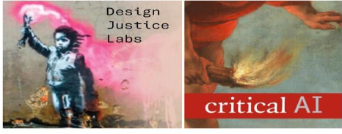
Design Justice Labs Pathway
Learn to teach critical AI literacies from a critical AI studies and design justice standpoint. Email us at criticalai@sas.rutgers.edu
DESIGN JUSTICE LABS is collaboration between NEH-supported grant initiatived (based at Rutgers but developed through transnational partnerships in the US, Australia, and South Africa); a Rutgers initiative for student-centered research on generative AI ; and an NSF-supported initiative for studying the design and impact of digitals for college writing

Slide 2
Competency 1 (understand how generative AI works and their possibilities and limitations in teaching and learning environments)
Rutgers scholars will develop foundational knowledge (milestone 1) through a series of online tutorials, readings, and the attendance of at least one affiliated workshop or reading group session.
Materials currently include our Student Guide, living document, and select readings from the first of a two-part special issue of Critical AI (edited at Rutgers and published by Duke University Press).

Slide 3
Competency 2: (Develop guidelines that address student usage of generative AI in ways that foster the achievement of learning outcomes)
Rutgers instructors will design and implement (milestone 2)
a syllabus and set of policies that adheres to all Design Justice Lab protocols including integration of Design Justice Network principles and adherence to Kathryn Conrad’s “Blueprint for an AI Bill of Rights for Education”; and
At least one assignment designed or redesigned in response to specific learning objectives and knowledge of critical AI literacies and design justice principles
Assessment of these pedagogical strategies (milestone 3) will entail peer reviewed publication on the new DESIGN JUSTICE LABS website (a public-facing store of resources for teachers, students, journalists, and other communities of practice in the design justice sphere).

Slide 4
Competency 3: Foster students’ critical AI literacies with respective “generative AI” tools and other digital affordances, including tool capabilities, limitations, and applications within the relevant framework; recognition of actually existing and prospective harms; and understanding of the current and potential obstacles to ethical and responsible usage. This competency relates to all milestones, including ongoing learning (milestone 5) which involves continued engagement in professional development on teaching and researching generative AI.
Rutgers instructors will develop their ongoing expertise (milestone 5) in teaching and researching critical AI literacies through options that may include: presenting to other instructors in DJL-sponsored events, publishing a thinkpiece or essay in Critical AI, participating in the NSF college writing research activities, and/or mentoring an undergraduate DESIGN JUSTICE LAB fellow on a publishable probing project.

