Slide 1
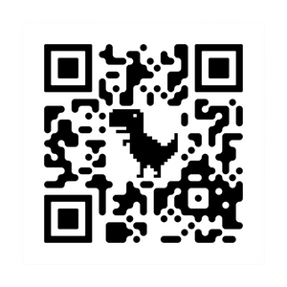










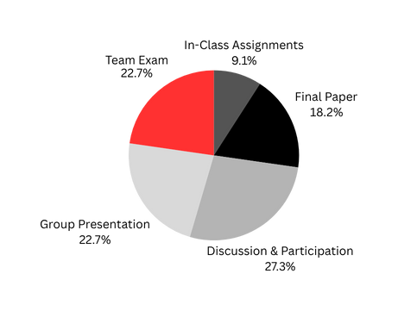





TITLE OF COURSE
Course code Semester Year
Link to the syllabus
Class weeks start on [DAY OF WEEK] at [TIME]. See Canvas for complete course schedule.
Professor Rutgers
Contact Me:
hello@reallygreatsite.com
LinkedIn Profile Page
By email or during student hours
COURSE PURPOSE & GOALS
Write one or two sentences about the purpose of this course.
Write one or two sentences about your goals for them.
Weeks 1-3
Dates
Topics Covered
Weeks 4-6
Dates
Topics Covered
Weeks 7-9
Dates
Topics Covered
Weeks 10-12
Dates
Topics Covered
Weeks 13-15
Dates
Topics Covered
SAVE THE DATE:
Exact Date
Important Project
Exact Date
Important Project
Exact Date
Important Project
Exact Date
Important Project
Exact Date
Important Project
ASSIGNMENT BREAKDOWN
My Goal is for you to understand why you’re completing these assignments.
  In-Class Assignments:
  Discussion and Participation:
  Team Exam:
  Group Presentation:
  Final Paper:
Be confident!
Be curious!
Be persistent!
Be engaged!

