Slide 1
The Rutgers Latino Information Network Advancing Rutgers’ Commitment to Diversity, Public Service & Excellence

Slide 2
U.S. Latino Market
1990, 2000, 2010 and 2015
Buying Power (billions of dollars)
1990 2000 2010 2015
Total $4,240 $7,324 $11,124 $14,119
Hispanic 210 499 1,036 1,482
Non-Hispanic 4,030 6,825 10,088 12,637
Source: Selig Center for Economic Growth, Terry College of Business, The University of Georgia, August 2010.

Slide 3
U.S. Latino Market
1990, 2000, 2010 and 2015
Percentage Change in Spending
1990-2010 1990-2015 2000-2010 2010-2015
Total 162.4% 233.0% 51.9% 26.9%
Hispanic 392.9 605.3 107.5 43.1
Non-Hisp 150.3 213.6 47.8 25.3
Source: Selig Center for Economic Growth, Terry College of Business, The University of Georgia, August 2010.

Slide 4
U.S. Latino Market
1990, 2000, 2010, and 2015
Market Share
(% /percents)
1990 2000 2010 2015
Total 100% 100% 100% 100%
Hispanic 5.0 6.8 9.3 10.5
Non-Hisp 95.0 93.2 90.7 89.5
Source: Selig Center for Economic Growth, Terry College of Business, The University of Georgia, August 2010.

Slide 5
U.S. Latino Market
2010 -- Nation’s Largest Consumer Markets
(In Billions)
California $265.2 bn
Texas 176.3
Florida 107.0
New York 81.3
Illinois 43.6
New Jersey 39.6
Arizona 33.9
Colorado 21.9
New Mexico 20.0
Georgia 17.0
Source: Selig Center for Economic Growth, Terry College of Business, The University of Georgia, August 2010

Slide 6
U.S. Latino Market
2010 -- Nation’s Most Concentrated Consumer Markets
(Percentage Share of Total Spending)
New Mexico 31.5%
Texas 20.7
California 18.7
Arizona 16.7
Florida 16.4
Nevada 15.9
Colorado 11.6
New Jersey 9.8
New York 9.7
Illinois 8.9

Slide 7
New Jersey Latino Market
NJ Latino Spending
(In billions)
1990 2000 2010 2015
NJ Total $164.3 $272.6 $399.2 $500.5
Latinos 8.9 19.6 39.3 55.4
% of Tot 5.4% 7.2% 9.8% 11.1%
Whites 144.6 229.9 325.1 400.3
Blacks 13.9 24.4 36.1 45.4
Asians 5.7 16.1 31.6 43.9
Native Amer 0.3 0.5 0.9 1.3
Source: Selig Center for Economic Growth, Terry College of Business, The University of Georgia, August 2010

Slide 8
New Jersey Latino Market
NJ Latino Spending
Percentage Change in Total, Latino and Non-Latino Spending
1990-2015
Total Latino Non-Latinos
New Jersey 204.6% 520,2% 186.5%
New York 185.6 358.1 173.6
Pennsylvania 178.8 953.9 170.7
Source: Selig Center for Economic Growth, Terry College of Business, The University of Georgia, August 2010

Slide 13
New Jersey Latino Market
Where Latinos Spend More
Groceries
Phone Services
Apparel
Footware
Where Latinos Spend Less
Alcohol and Tobacco
Health Care
Entertainment
Education
Personal Insurance

Slide 14
New Jersey Latino Market
N.J. Latino-Owned Businesses
2002 2007 % +/(-)
Tot NJ Lat-Own Bus 49,841 68,362 37.1%
Tot Receipts $7.5 bn $10.2 bn 42.4%
Avg Revenue/Bus $150,478 $148,502 (1.3%)
Source: U.S. Census Bureau

Slide 15
New Jersey Latino Market
Latino-Owned Businesses in NJ, NYC & Philly
2002 2007 % +/(-)
Total NJ Lat-Own 49,841 68,362 37.1%
Total NYC Lat-Own 163,588 193,255 18.1%
Total PHI Lat-Own 11,023 22,797 106.8%
TOTALS 224,452 284,414 26.7%
Source: U.S. Census Bureau

Slide 16
New Jersey Latino Market
Latino-Owned Businesses in NJ, NYC & Philly
2002 2007 % +/(-)
Total NJ Receipts $7.5 bn $10.2 bn 42.2%
Total NYC Receipts 12.3 bn 18.3 bn 48.4%
Total PHI Receipts 1.7 bn 3.3 bn 89.6%
TOTALS $21.5 bn $31.8 bn 47.9%
Source: U.S. Census Bureau

Slide 17
New Jersey Latino Market
Latino-Owned Businesses in NJ, NYC & Philly
2002 2007 % +/(-)
Tot NJ Avg Rev/Bus $150,478 $148,502 (1.3%)
Tot NYC Avg Rev/Bus 75,188 94,693 25.9%
Tot PHI Avg Rev/Bus 154,222 144,755 (6.1%)
TOTALS $95,789 $111,809 16.7%
Source: U.S. Census Bureau

Slide 18
New Jersey Latino Market
N.J. Latina-Owned Businesses
2002 2007
% of Tot. Lat-Own Firms 30% 30%
Total Latina-Owned Firms 14,952 20,509
+37.2%
Source: U.S. Census Bureau

Slide 19
New Jersey Latino Market
The Downside of the Economic Picture
Percentage of NJ Latinos living in poverty: 18.3%
Percentage represents 265,350 Latino individuals
Latinos represent 35% of 757,600 living in poverty in NJ
Percentage of NJ Latinos without health care: 29.1%
Percentage represents 421,950 Latino individuals
Latinos represent 38.5% of 1.1 million living without
health care in NJ
Source: U.S. Census Bureau

Slide 20
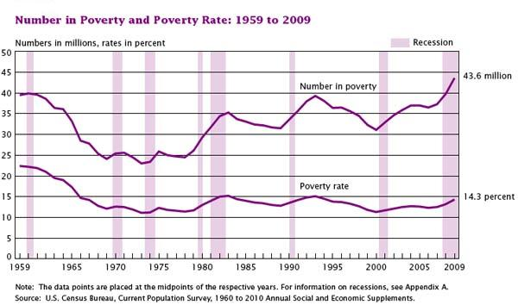
National Poverty

Slide 21
Poverty in New Jersey

Slide 22
Poverty in New Jersey

Slide 25
The Rutgers Latino Information Network Advancing Rutgers’ Commitment to Diversity, Public Service & Excellence
Principal Investigators: Aldo Santiago, Yolanda San Miguel
Project Director: Robert Montemayor
Sponsors: Phil Furmanski, Doug Greenberg, Jorge Schement, Verizon

Slide 26
National Poverty

