Slide 1
N-heterocyclic carbenes
2. Hydrogen bonding/Brønsted acid
3. Nucleophilic catalysts

Slide 2
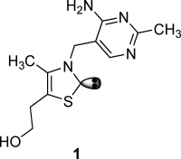
1. Carbene
No formal charge
Bivalent carbon
A carbon with 6 electrons around it
Also has its roots in enzymes
Coenzyme thiamine (vitamin B₁)

Slide 3
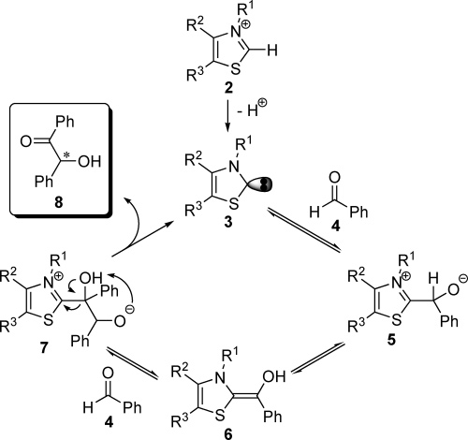
thiazolium salt
Breslow (1958)
Benzoin condensation=
coupling of 2 aldehyde
carbons
These carbenes enable
Umpolung reactivity. A
carbon that is normally
electrophilic (i.e.,
carbonyl carbon) acts
as a nucleophile.
Breslow intermediate

Slide 4

Arduengo (1991)
People thought carbenes were reactive intermediates, too unstable to be
isolated
First N-heterocyclic carbene to be
isolated and characterized
Since then, N-heterocylic carbenes
have found numerous applications in
metal-based catalysis and organocatalysis
Enders (1995) synthesizes triazole-based carbene, which is first carbne to
become commercially available
R = Ad

Slide 5
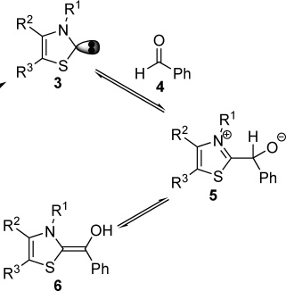
a1 to d1 Umpolung
acceptor 1 to donor 1 (carbon 1 =
carbonyl carbon; acceptor =
electrophile)
Benzoin condensation + variations
Stetter reaction
R = Ad

Slide 6
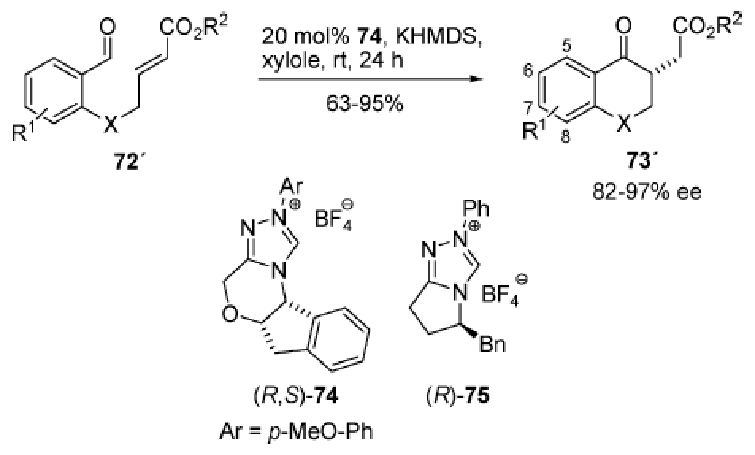
Stetter reaction
Essentially a Benzoin condensation, but nucelophilic carbonyl carbon adds
1,4 to an α,β-unsaturated carbonyl
SM is salicylaldehyde derivative
PDT is chromane
Rovis = first highly
selective example
Kerr, M. S.; Read de Alaniz, J.; Rovis, T. J. Am. Chem. Soc. 2002, 124, 10298.

Slide 7
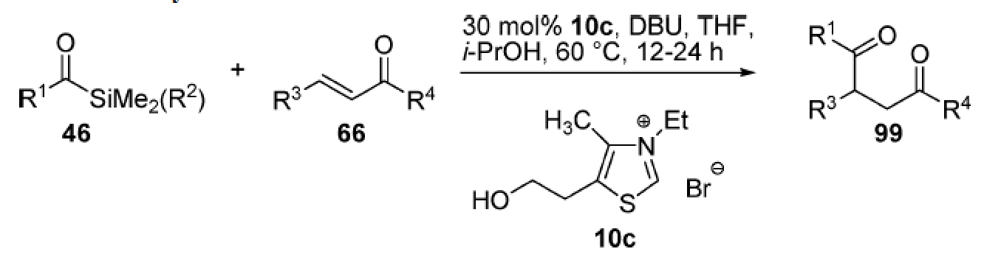
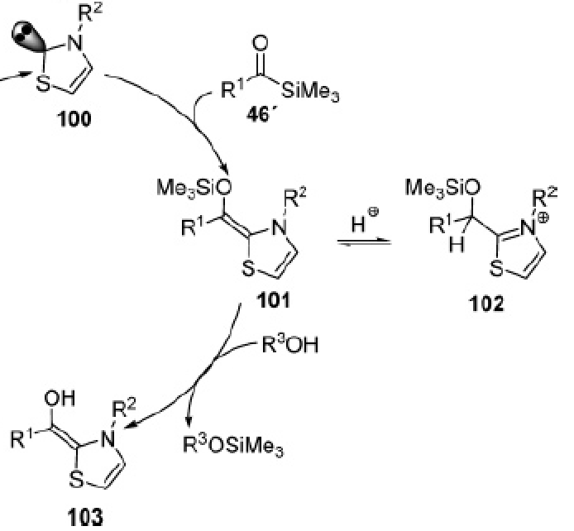
Sila-Stetter reaction
Overcomes the challenge of intermolecular Stetter reactions = self Benzoin
condensation
Scheidt (not
asymmetric?)
Brook rearrangement
1,2-silyl shift
Mattson, A. E.; Bharadwaj, A. R.; Scheidt,
K. A. J. Am. Chem. Soc. 2004, 126, 2314.

Slide 8
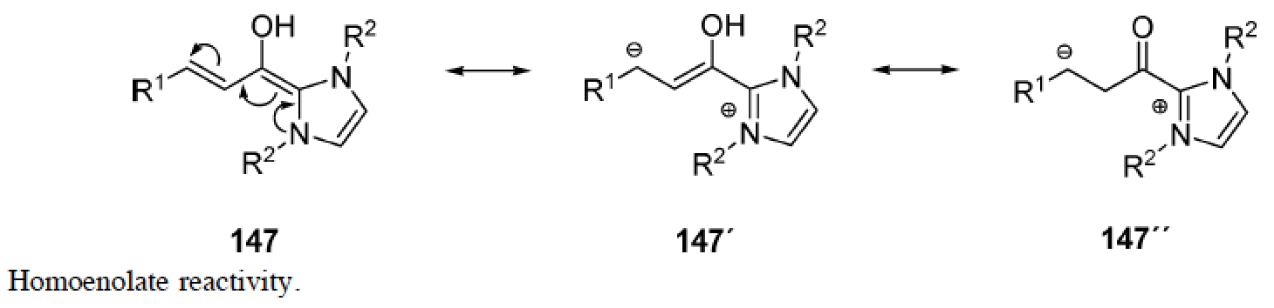
a3 to d3 Umpolung
Renders β carbon of α,β-unsaturated aldehyde nucleophilic
Cross condensation of enals with aldehydes, imines, 1,2-diones, enones
(i.e., 1,2- and 1,4-addition by β-carbon)
Protonation at β position

Slide 9
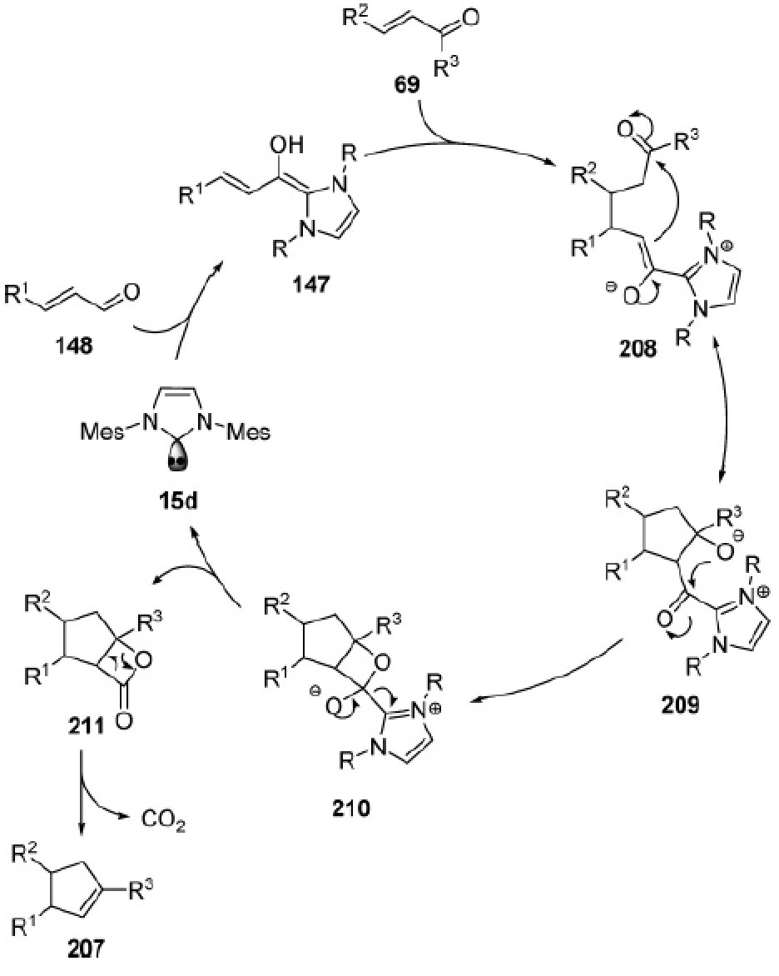
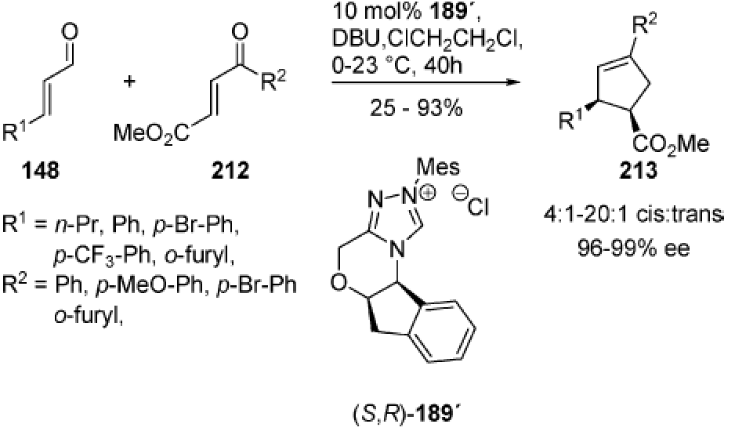
a3 to d3 Umpolung
Chiang, P. C.; Kaeobamrung, J.; Bode, J. W. J. Am. Chem. Soc. 2007, 129, 3520.
Nair developed non-asymmetric version in JACS the year before.

Slide 10
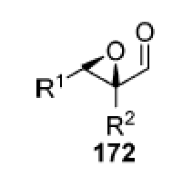
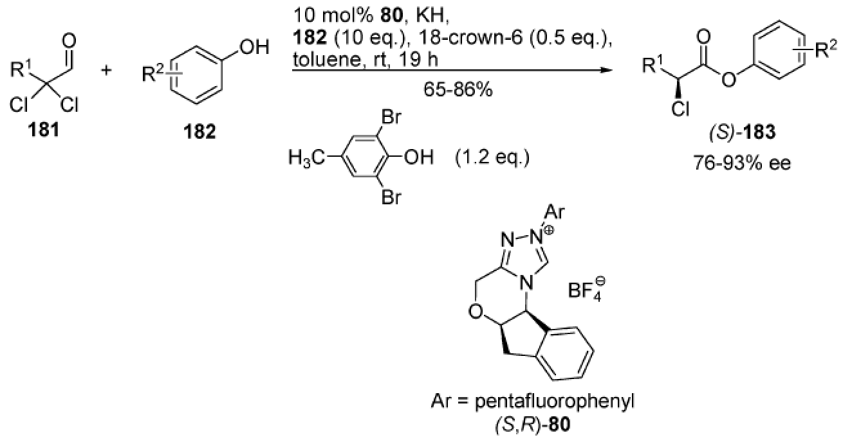
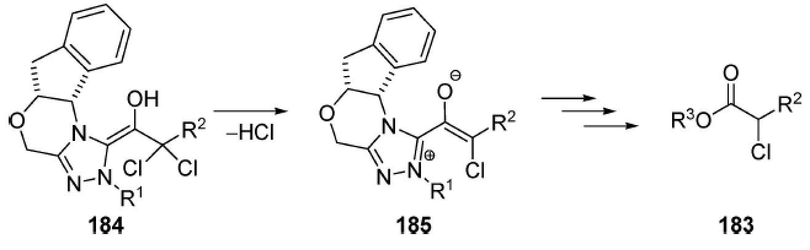
Acyl anion equivalents
Requires leaving group (halogen, epoxide, aziridine) at α carbon
Nucleophilic at α carbon
aldehyde C oxidized and α C rendered chiral (in below example)
Reynolds, N. T.; Rovis, T. J. Am. Chem. Soc. 2005, 127, 16406.

Slide 11
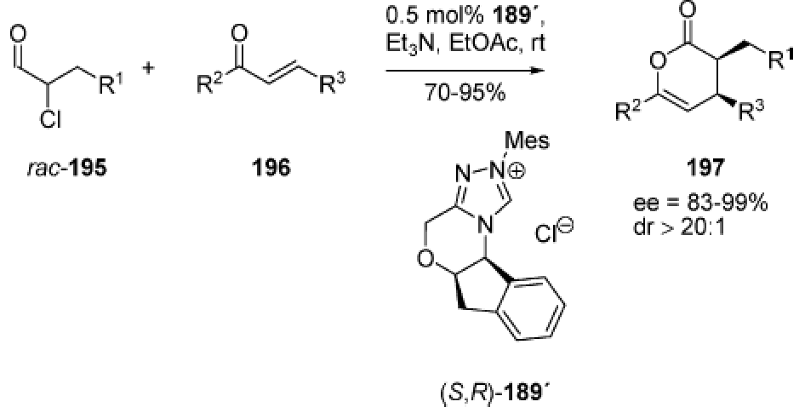
Acyl anion equivalents
Inverse electron demand hetero Diels-Alder
Really nice applications in organocatalytic ROP (ring opening polymerization)
Coulembier, O.; Dove, A. P.; Pratt, R. C.; Sentman, A. C.; Culkin, D. A.;
Mespouille, L.; Dubois, P.; Waymouth, R. M.; Hedrick, J. L. Angew. Chem. Int.
Ed. 2005, 44, 4964.
He, M.; Ue Gerson, J.; Bode, J. W. J. Am. Chem. Soc. 2006, 128, 15088.

Slide 12
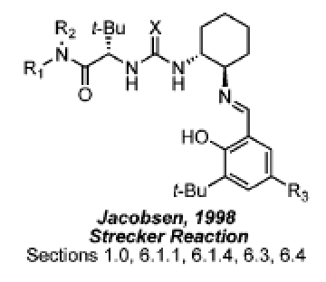
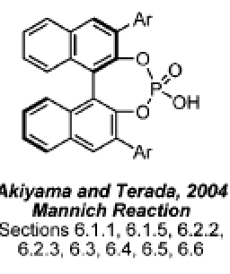
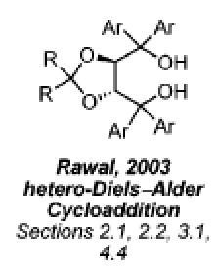
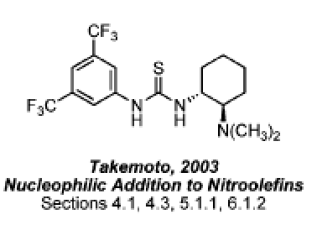
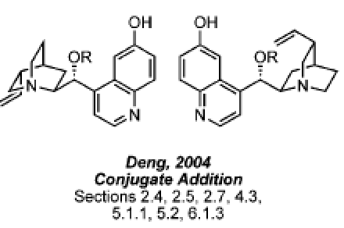
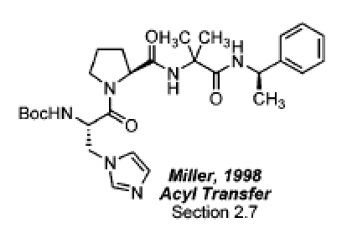
Brønsted acid / Hydrogen Bond Donors
NON-COVALENT
pKa (DMSO) = 21
pKa (DMSO) = 28
pKa (DMSO) = 1
Bifunctional

Slide 13
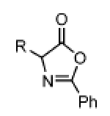
Brønsted acid / Hydrogen Bond Donors
Carbonyl
  Aldol (TADDOL: Mukaiyama aldol)
  HDA (TADDOL)
  Baylis-Hillman (Cinchona, TU)
  Henry (Cinchona, bifuncTU)
  Friedel-Crafts (Cinchona)
  Cyanation (bifuncTU)
  Resolutions (peptide, Cinchona, bifuncTU: azlactones)
Nitrosobenzene
  Nitrosoaldol (TADDOL)
α,β-unsaturated carbonyl
  Thiol (Cinchona, bifuncTU)
  Epoxidation
  1,3-dicarbonyl et. al. (Cinchona, bifuncTU)
  Diels-Alder (TADDOL)
Nitroalkenes
  Conjugate additions (Cinchona, bifuncTU)
Imines
  Mannich (PA, TU, bifuncTU, Cinchona)
  Baylis-Hillman (Cinchona, TU)
  Biginelli (multicomponent; PA)
  Pictet-Spengler (TU, PA)
Activate pi bonds involving at least 1
heteroatom of the type X=Y, where
when X = C, Y = O, N
when X = N, Y = O
Chiral α-amino
acid precursor
Strecker (TU, PA)
HDA (PA)
Phosphorous
Nucleophiles (TU, PA)
Reduction (PA)

Slide 14
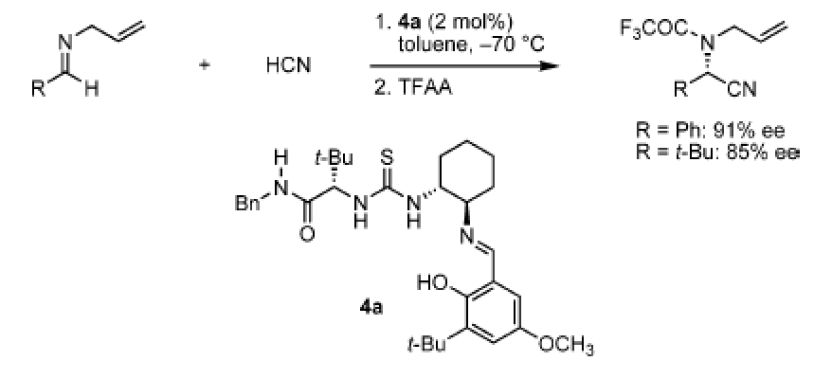
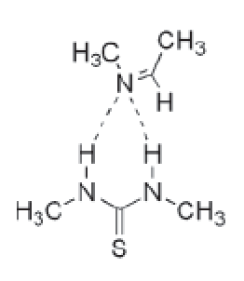
Strecker Reaction
Double hydrogen bond donation
  NMR, kinetic, structure-activity, and theoretical studies
  First example of chiral thiourea catalyst
Sigman, M. S.; Jacobsen, E. N. J. Am. Chem. Soc. 1998, 120, 4901.

Slide 15
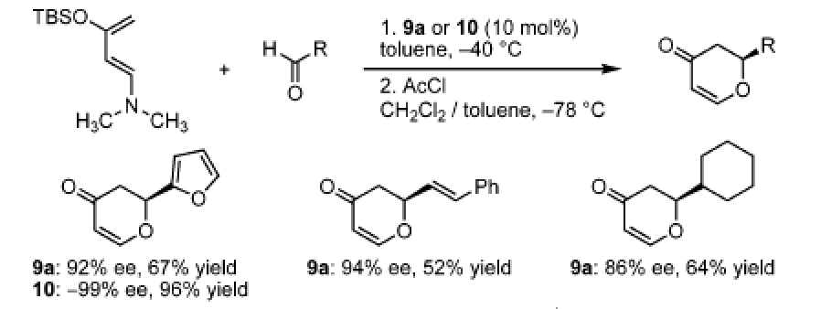
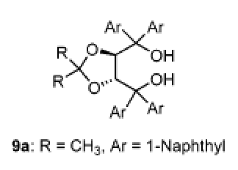
Carbonyl electrophiles
Hetero-Diels-Alder
  First example of TADDOL catalysts
  Catalysts developed after observation that protic solvents (i.e., 2-butanol)
  accelerated the HDA reaction of unactivated aldehydes and ketones
Huang, Y.; Unni, A. K.; Thadani, A. N.; Rawal, V. H. Nature 2003, 424, 146.

Slide 16
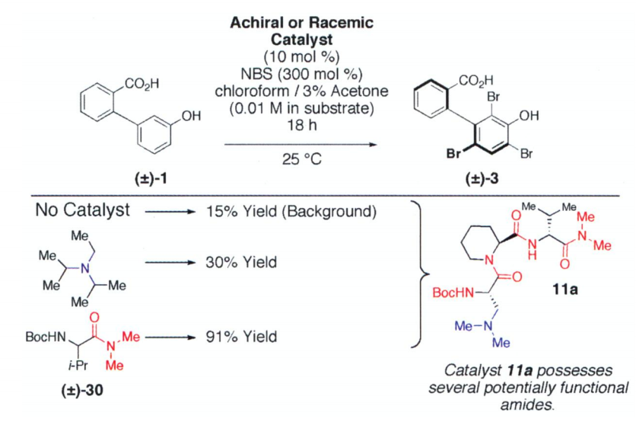
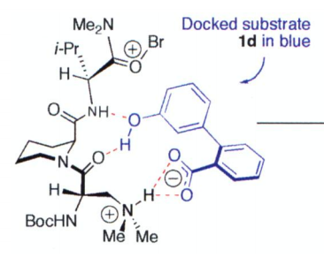
Miller
DKR of biaryl atropisomers
In this case, enantiomers arising because of hindered rotation about a single bond
Combinatorial approach to catalyst development
Gustafson, J. L.; Lim, D.; Miller, S. J. Science 2010, 328, 1251.

Slide 17
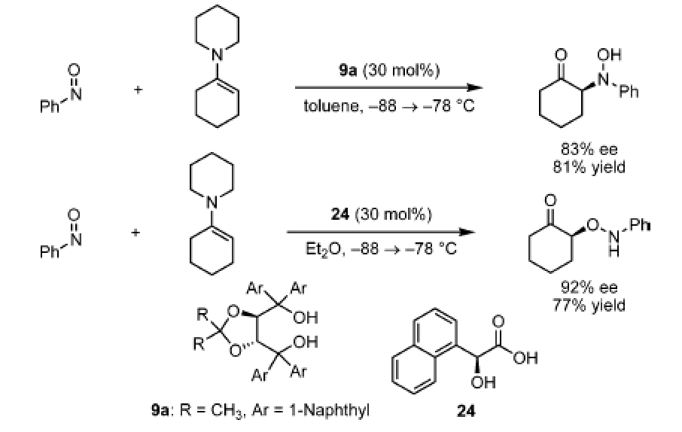
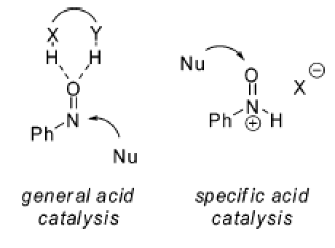
Nitrosobenzene
Nitroso aldol
Momiyama, N.; Yamamoto, H. J. Am. Chem. Soc. 2005, 127, 1080.

Slide 18
Nitroalkenes
Conjugate addition of 1,3-dicarbonyls or equivalent
  The “go to” reaction
  The first documented example of a catalytic enantioselective conjugate
  addition was a cinchona alkaloid-catalyzed addition of a 1,3-dicarbonyl
  (cyclic β-ketoester) to an α,β-unsaturated carbonyl (methyl vinyl ketone;
  Wynberg, 1975)
  First use of cinchona alkaloid-derived bifunctional hydrogen bonding catalyst
  developed by Deng, which he has since made a career out of using, was in
  conjugate addition of dimethyl malonate to β-nitrostyrene
  In naturally occurring cinchona alkaloids, R = H, and there is either an H or
  an OMe where the phenol is. By swapping
  ether/alcohol sites, Deng winds up with a
  stronger hydrogen bond donor (phenol vs.
  benzyl alcohol)
Li, H.; Wang, Y.; Tang, L.; Deng, L. J. Am. Chem. Soc. 2004, 126, 9906.

Slide 19
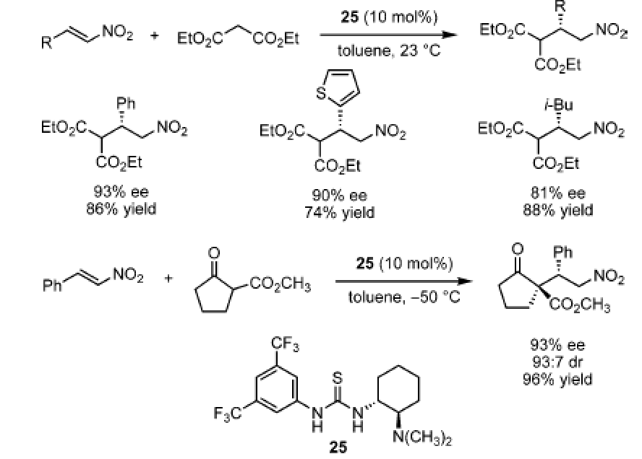
Nitroalkenes
Conjugate addition of 1,3-dicarbonyls or equivalent
  First example of this specific bifunctional thiourea catalyst, which were
  extensively developed afterwards, and are effective activators of a
  broad array of functional groups
Takemoto
Soós, Pápai
(1 H bond
per O)
Okino, T.; Hoashi, Y.; Takemoto, Y. J. Am. Chem. Soc. 2003, 125, 12672.
Wittkopp, A.; Schreiner, P. R. Chem. Eur. J. 2003, 9, 407.

Slide 20
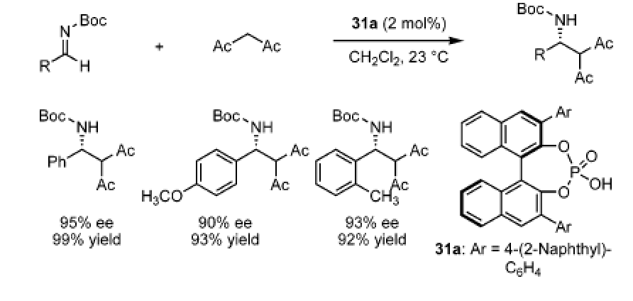
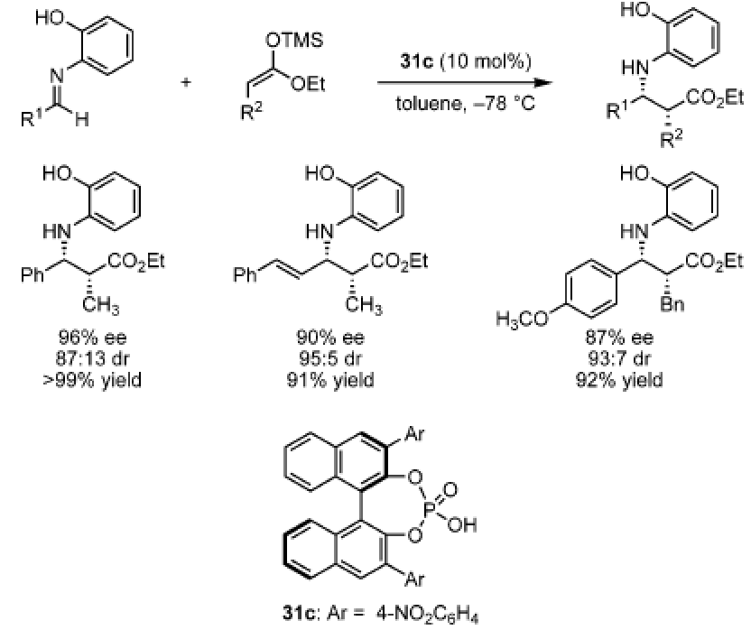
Imines
“Compared to carbonyl compounds, imines are relative strong and directional H
bond acceptors and therefore among the best potential substrates for
enantioselective H-bond donor catalysis…The majority of applications of
asymmetric H-bonding catalysis have been…additions to imines.”
Uraguchi, D.; Terada, M. J. Am.
Chem. Soc. 2004, 126, 5356.
**TRIP**
Akiyama, T.; Itoh, J.; Yokota, K.; Fuchibe, K. Angew. Chem. Int. Ed. 2004, 43, 1566.

Slide 21
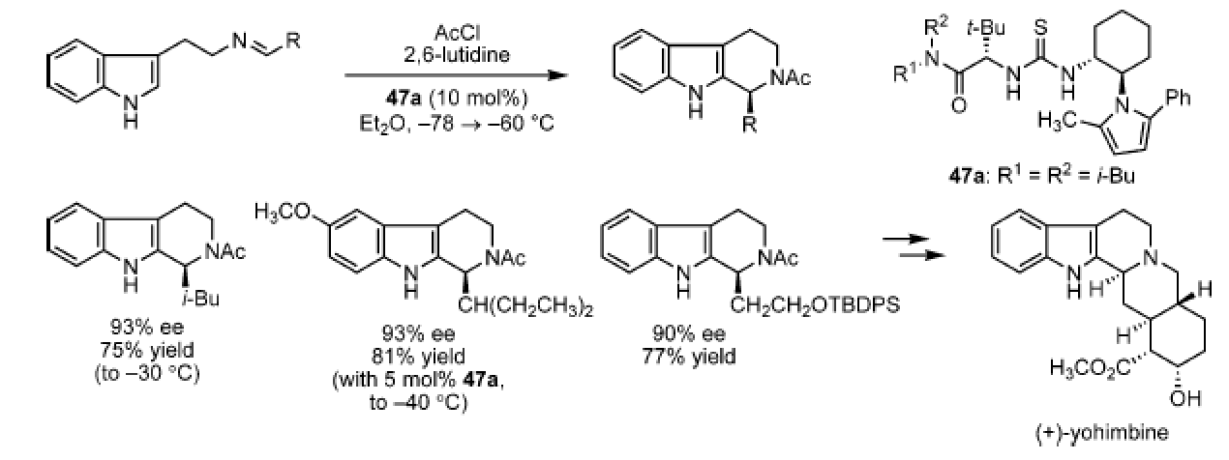
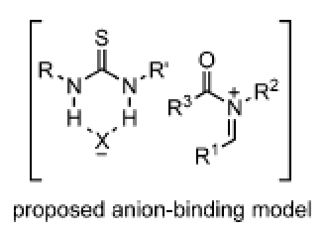
Pictet-Spengler
A Friedel-Crafts
Cyclization of electron-rich aryl or heteroaryl groups onto iminium
Instead of activating electrophile or nucleophile, leaving group is activated.
Multi-H bond donors are known to act in an anion binding capacity.
Taylor, M. S.; Jacobsen, E. N. J. Am. Chem. Soc. 2004, 126, 10558.

Slide 22
Nucleophilic catalysts
Primarily heterocyclic aromatic or tertiary (i.e., cinchona) amines and phosphines
Phosphine catalysts R₃P:
R = Ar; well established in metal catalysis, low nucleophilicity and poor
enantioselectivity in organocatalysis
R = Alk; better for the purposes of organocatalysis, but challenging to
synthesize and easily air oxidized

Slide 23
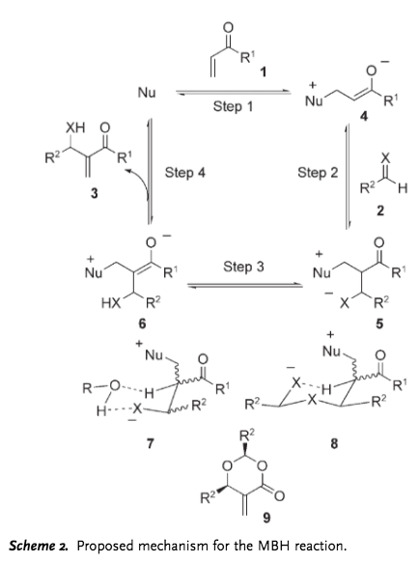
Morita-Baylis-Hillman
and aza-MBH (X = N)

Slide 24
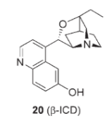
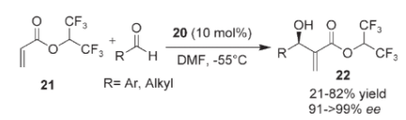
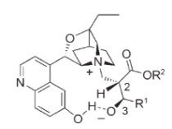
Morita-Baylis-Hillman and aza-MBH
A bifunctional catalyst:
nucleophile and H-bond
donor
Iwabuchi, Y.; Nakatani, M.; Yokoyama, N.; Hatakeyama, S. J. Am. Chem. Soc. 1999, 121, 10219.

Slide 25
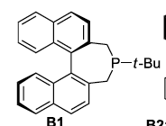
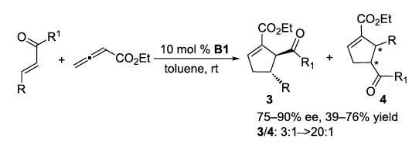
3+2 cycloadditions of allenes
The most studies class of reactions with phosphine catalysts
First example by Zhang in 1997
Didn’t take off until 10 years later
allene
Wilson, J. E.; Fu, G. C. Angew. Chem. Int. Ed. 2006, 45, 1426.

Slide 26
Mechanism
Minor pdt

Slide 27
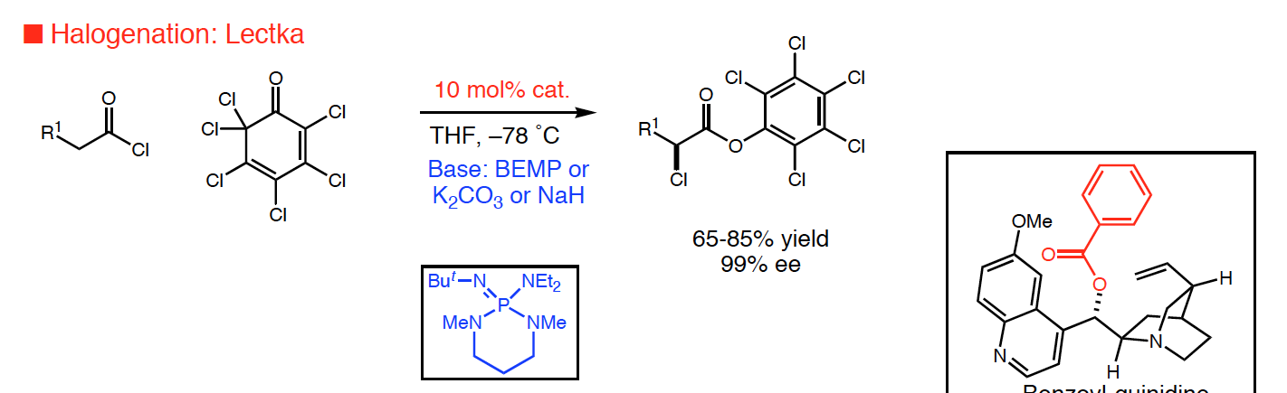

ketene
The first organocatalytic α-halogenation of carbonyl compounds.
Wack, H.; Taggi, A. E.; Hafez, A. M.; Drury III, W. J.; Lectka, T. J. Am. Chem.
Soc. 2001, 123, 1531.

Slide 28

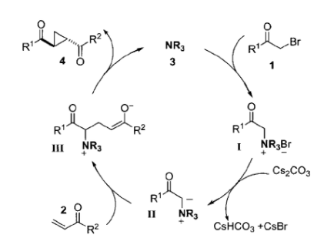
Cyclopropanation
Papageorgiou, C. D.; Cubillo de Dios, M. A.; Ley, S. V.; Gaunt, M. J.
Angew. Chem. Int. Ed. 2004, 43, 4641.

