Slide 1
Bifunctional catalyst = 1 catalyst doing 2 different things
Cooperative (synergistic) catalysts = 2 different catalysts, each doing something different

Slide 2
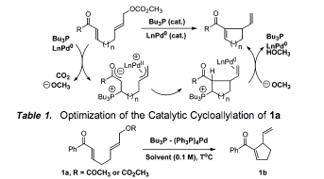
Combining organo- and metal-catalysis
Stoichiometric in trialkyl phosphine organocatalyst
Soft nucleophile (resonance-stabilized carbanion) attacks carbon to reductively eliminate off Pd; does NOT
attack Pd center = Tsuji-Trost allylation
Jellerichs, B. G.; Kong, J.-R.; Krische, M. J. J. Am. Chem. Soc. 2003, 125, 7758.

Slide 3
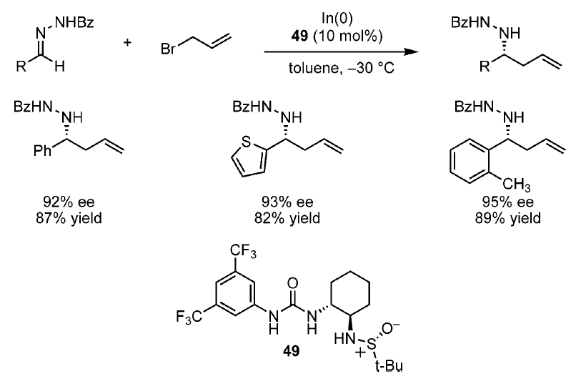
Thiourea and metal-catalysis
H-bond rigidifies catalyst,
enables high enantioselectivity.
Tan, K. L.; Jacobsen, E. N. Angew. Chem. Int. Ed. 2007, 46, 1315.

Slide 4
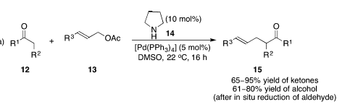
It was thought that amino- and metal-catalysts would be incompatible
First example of enamine- and metal-catalyzed allylation
Mechanism is analogous to phosphine organo- and Pd-catalyzed allylation, where an enamine is a nucleophile
instead of an enolate.
Ibrahem, I.; Córdova, A. Angew. Chem. Int. Ed. 2006, 45, 1952-1956.

Slide 5
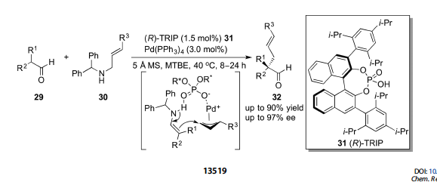
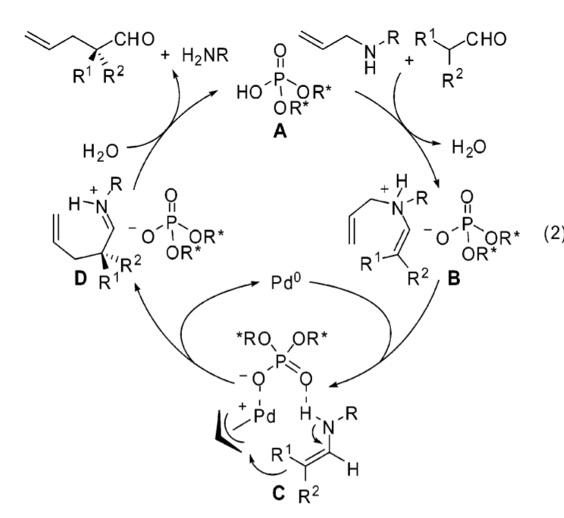
First asymmetric intermolecular example
Can be made stoichiometric through use of either chiral organocatalyst or chiral ligands on Pd
Stoichiometric in amine
Cooperative catalysis: amine + phosphoric acid organocatalysts (+ transition metal)
Phosphoric acid conjugate base could be chiral counterion or chiral ligand for Pd. Subsequent computational
studies support the proposed chiral counterion mechanism.
Mukherjee, S.; List, B. J. Am. Chem. Soc. 2007, 129, 11336.

Slide 6
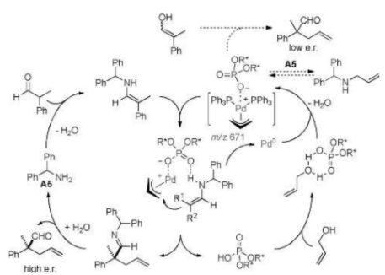
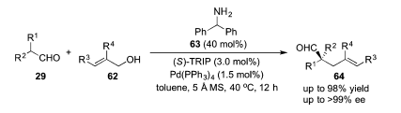
First asymmetric intermolecular example
A later version is catalytic in amine and uses free allyl alcohols as allyl source
Jiang, G.; List, B. Angew. Chem. Int. Ed. 2011, 50, 9471.

Slide 7
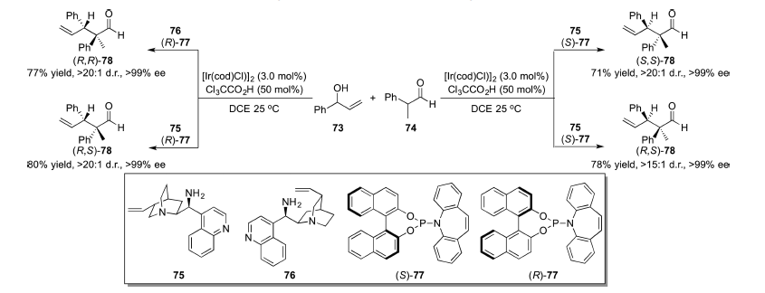
Another notable example
”Dual catalysis for stereodivergent control”
By using a chiral organocatalyst and chiral ligands on metal (IR), all 4 stereoisomers can be accessed
Linear and branched aldehydes
Again, free allyl alcohols used as allyl source
76
Krautwald, S.; Sarlah, D.; Schafroth, M. A.; Carreira, E. M. Science 2013, 340, 1065.

Slide 8
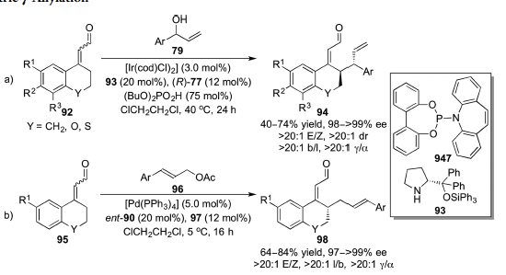
One final notable example
Combination of dienamine- and metal-catalysis
Substrate heavily biased towards γ-functionalization (Trick 2)
sole example of γ-allylation of enal/enone
Næsborg, L.; Halskov, K. S.; Tur, F.; Mønsted, S. M. N.; Jørgensen, K. A. Angew. Chem. Int. Ed. 2015, 54, 10193.

Slide 9


Whereas previous examples weren’t traditional
“coupling” mechanisms, these are also possible.
Heck-type reaction
alternatively,
mechanism
1.5 equiv of base
could just be neutralizing
HBr
+ charge on N: can’t be
protonated, bc 1.5 equiv
of base.
?!?!
(syn elimination!
…but, they are proposing
E2 elimination)
Liu R.-R.; Li, B.-L.; Lu, J.; Shen, C.; Gao, J.-R.; Jia, Y.-X. J. Am. Chem. Soc. 2016, 138, 5198.

Slide 10
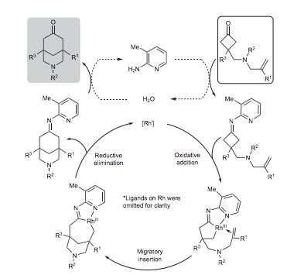
Can also have C-C insertion, which we won’t talk about (see for example, Nature Chemistry
2014, 6, 739), and C-H insertion, which we will talk about. We’ll also cover organo- and photoredox catalysis later on.
*stoichiometric in
organocat

Slide 11

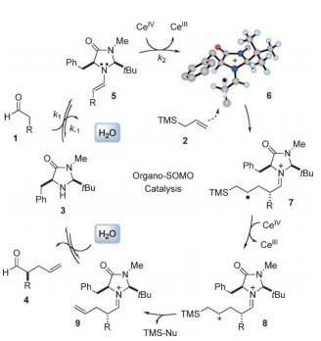


SOMO
You’ve heard of HOMO, LUMO…
α-allylation
=
CAN = ceric ammonium nitrate = (NH₄)₂Ce(NO₂)₆
single electron oxidant
Evidence for radical vs. cationic mechanism
Nu can be nitrate,
water, carbonate
Si stabilizes α anions,
β cations
Beeson, T. D.; Mastracchio, A.; Hong, J.-B.; Ashton, K.; MacMillan, D. W. C. Science 2007, 316, 582.

Slide 12
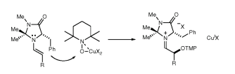
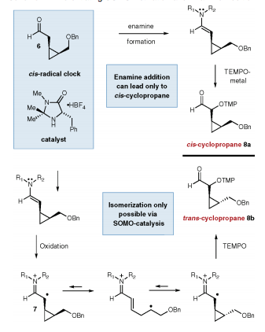
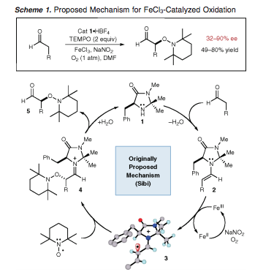
SOMO is distinct from synergistic catalysis. In SOMO,
organocatalyst and metal catalyst activate same reactant,
and radical intermediates are involved. In synergistic
catalysis, organocatalyst and metal catalyst activate
different reactants (or different functionalities within the
same reactant, if intramolecular), and organoradical
intermediates are not involved.
The allylation reactions discussed earlier would be
synergistic catalysis.
Revised “closed shell” mechanism based on below
studies.
Van Humbeck, J. F.; Simonovich, S. P.; Knowles, R. R.; MacMillan, D. W. C. J. Am. Chem. Soc. 2010, 132, 10012.
Sibi, M. P.; Hasegawa, M. J. Am. Chem. Soc. 2007, 129, 4124.

Slide 13

SOMO
stoichiometric in oxidant (or you need a reoxidant)
metal oxidants
transformations
CAN = ceric ammonium nitrate = (NH₄)₂Ce(NO₂)₆
single electron oxidant
α-allylation
α-vinylation
vinyl trifluoroborate
salts
Fe(phen)₃.(PF₆)₃
α-enolation (using silyl enol ethers)
Cu(TFA)₂; Cu(II)
intramolecular arylation
nitronate
“carbo-oxidation” of styrene (addition of
α-carbon and nitrate from CAN across
double bond of styrene)
α-chlorination using LiCl
as chlorine source
intra/intermolecular cascades
to generate rings

Slide 14
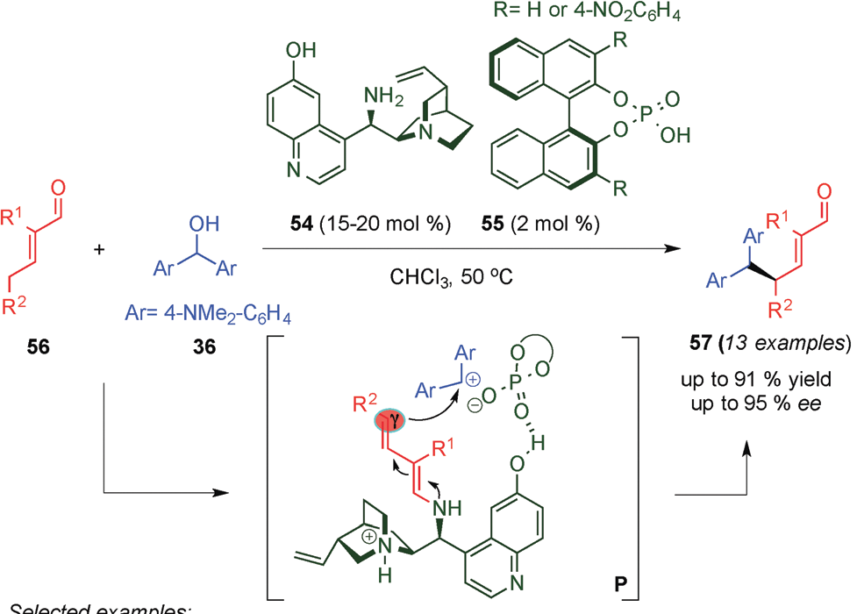
Cooperative catalysis between 2 different classes of organocatalysts.
A transformation we’ve already seen…
Bergonzini, G.; Vera, S.; Melchiorre,
P. Angew. Chem. Int. Ed. 2010, 49,
9685.

Slide 15
CASCADE REACTIONS
consecutive, multiple bond formation
Dienamine-, iminium-, and enamine catalyzed reactions have
complementary mechanisms that facilitate combining more than
one transformation into one flask

Slide 16
Domino: “two or more bond-forming reactions…under the same reaction conditions,
without adding additional reagents and catalysts…in which the subsequent reactions
result as a consequence of the functionality formed in the previous step.” One catalyst
or multicatalytic, but all catalysts must be present from the outset.
Tietze, L. F. Chem. Rev. 1996, 96, 115.
Cascade has been used interchangeably, however Tietze does not advocate this.
Tandem means “two at the same time and does not describe a time-resolved transformation”.
Tandem: “Coupled catalyses in which sequential transformation of the substrate occurs via
two (or more) mechanistically distinct processes.”
Fogg, D. E.; dos Santos, E. N. Coord. Chem. Rev. 2004, 248, 2365.
Regardless, all three are multicomponent.

Slide 17
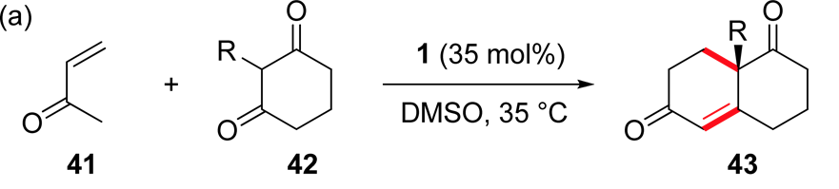
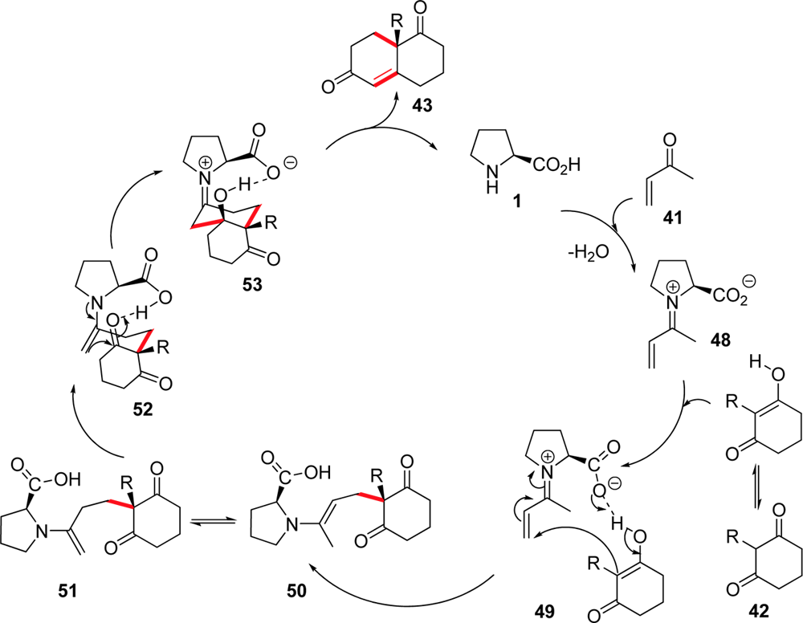
Domino reactions
  Early example
  Barbas
    Proline-catalyzed Robinson annulation
Bui, T.; Barbas, C. F.
Tetrahedron Lett. 2000, 41, 6951.
49%, 76% ee

Slide 18
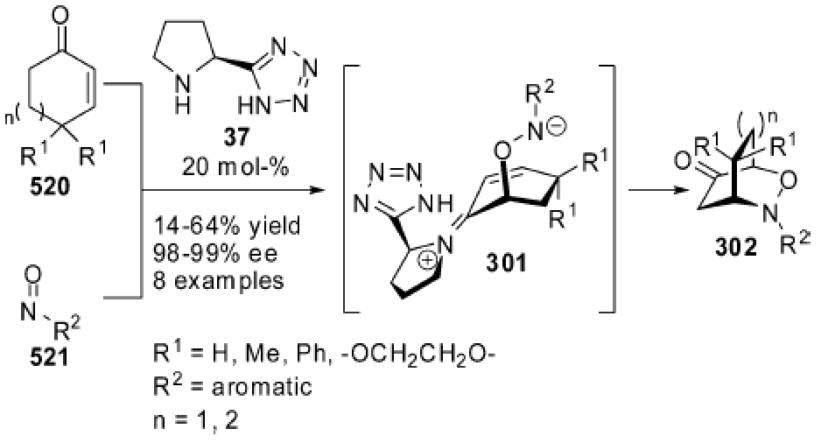
Domino reactions
  Early example of dienamine catalysis in a cascade reaction
  Barbas (cross conjugated) dienamine
    O-nitroso aldol—aza-Michael (a non-concerted Diels-Alder reaction)
49%, 76% ee
Yamamoto, Y.; Momiyama, N.; Yamamoto, H. J. Am. Chem. Soc. 2004, 126, 5962.

Slide 19
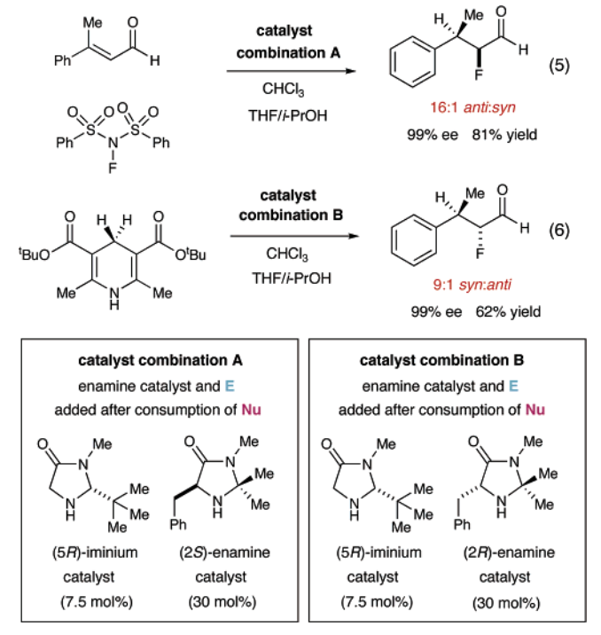
Domino reactions
  MacMillan
    “organomulticatalysis” (cycle specific)
    Allows access to all stereoisomers (both enantiomers of both diastereomers)
    Intermolecular
    cascades
*Technically, this is a
tandem reaction?
Huang, Y.; Walji, A. M.; Larsen, C. H.; MacMillan, D. W. C. J. Am. Chem. Soc. 2005, 127, 15051-15053.

Slide 20
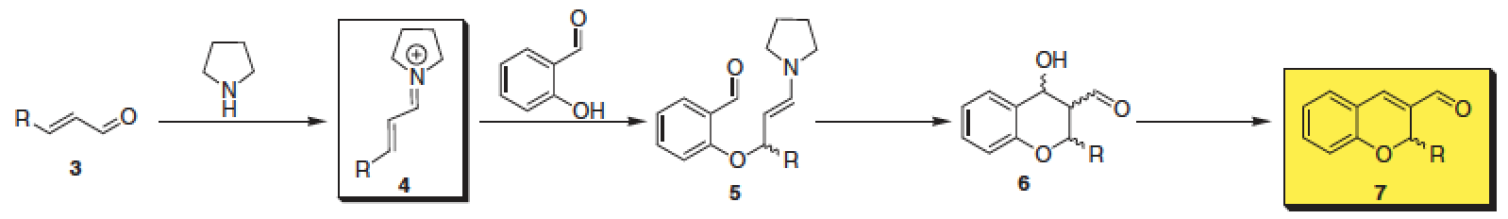
Domino reactions
  Easy access to ring systems
    3-, 5-, 6-membered rings; carbocycles, heterocycles; fused, spiro, and bridged ring systems
  Cascade reactions provide a way to overcome reversible, nonselective addition of Nu to conjugated iminium ions (i.e., oxa-Michael)
  benzopyran (chromene) = a structural core of natural and synthetic bioactive compounds
Govender, T.; Hojabri, L.; Moghaddam, F. M.; Arvidsson, P. I.
Tetrahedron: Asymm. 2006, 17, 1763-1767. and others

Slide 21
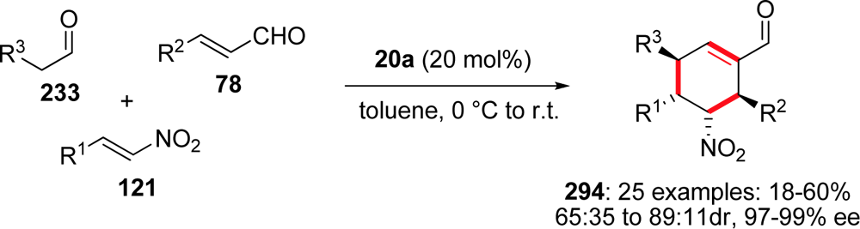
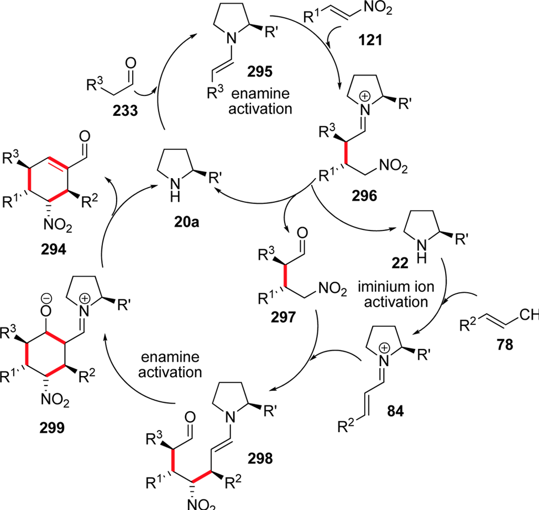
Domino reactions
  Multicomponent (triple cascade)
Enders, D.; Hüttl, M. R. M.; Grondal, C.; Raabe, G. Nature 2006, 44, 861.

Slide 22
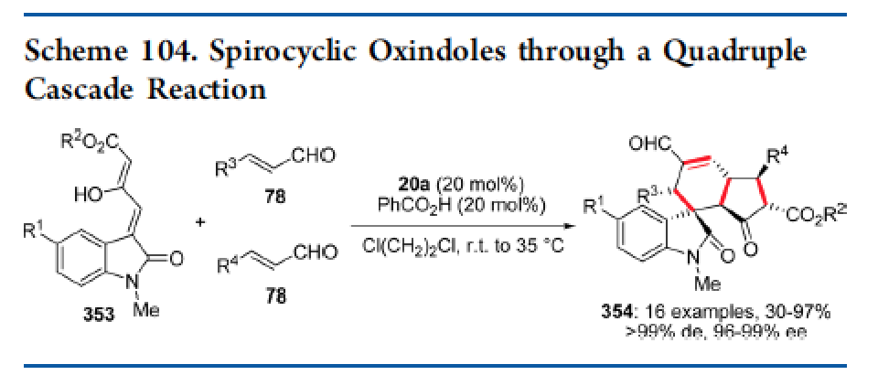
Domino reactions
  3-component, quadruple cascade (iminium-enamine-iminium-enamine)
  Rapidly build complex systems
    Multiple ring systems, multiple stereocenters, quaternary stereocenters
Jiang, K.; Jia, Z.-J.; Yin, X.; Wu, L.; Chen, Y.-C. Org. Lett. 2010, 12, 2766.

Slide 23
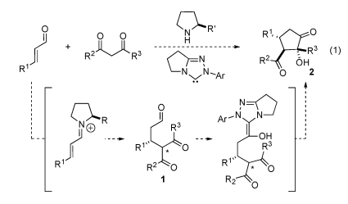
Domino reactions
  can combine different classes of organocatalysts
Lathrop, S. P.; Rovis, T. J. Am. Chem. Soc. 2009, 131, 13628.

Slide 24
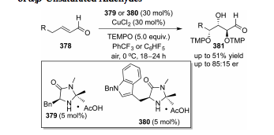
Domino reactions
  dienamine-iminium-enamine cascade establishes a stereotriad
  “double dynamic kinetic resolution” = γ- and β-stereocenters are introduced reversibly and as a racemic mixture of the cis diastereomer
  only; α-oxygenation sets all 3 stereocenters
Chen. J. S.; Abeykoon, G. A. Org. Lett. 2015, 17, 6050.

Slide 25

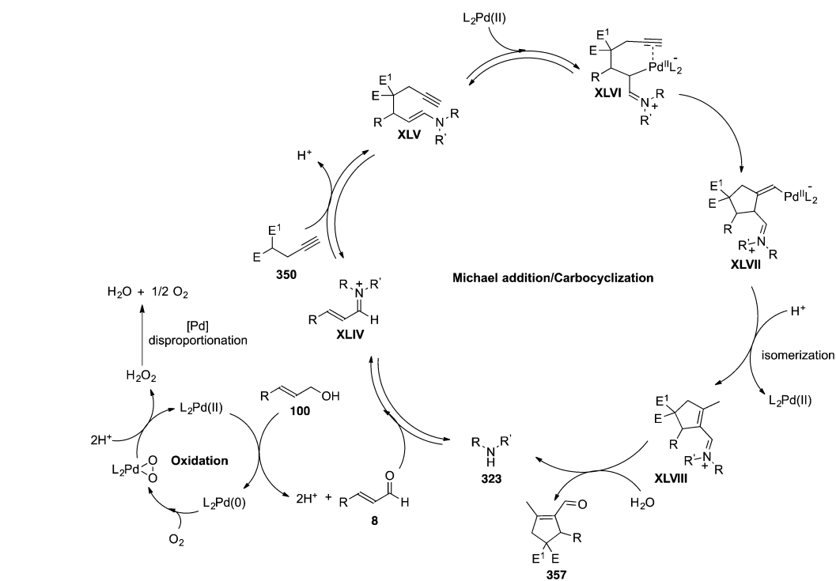
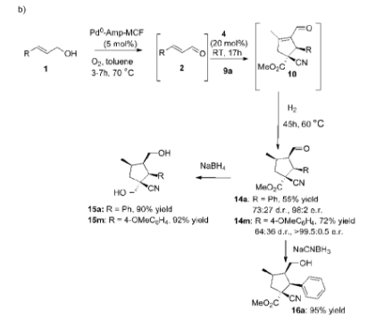

Tandem reactions
  combines heterogeneous metal catalysis with organocatalysis
Deiana, L.; Jiang, Y.; Palo-Nieto, C.; Afewerki, S.; Incerti-Pradillos, C. A.; Verho, O.; Tai, C.-W.;
Johnston, E. V.; Córdova, A. Angew. Chem. Int. Ed. 2014, 53, 3447.

Slide 26
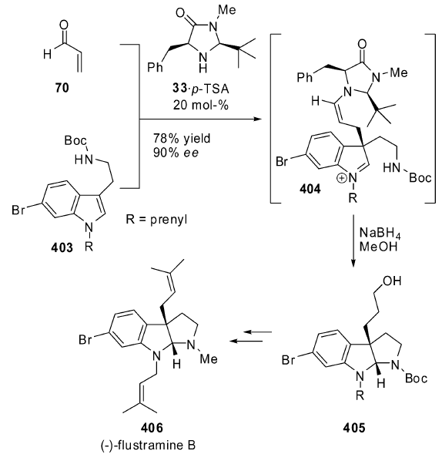
Synthesis
Austin, J. F.; Kim, S.-G.; Sinz, C. J.; Xiao, W.-J.; MacMillan,
D. W. C. Proc. Natl. Acad. Sci. USA 2004, 101, 5482.

Slide 27
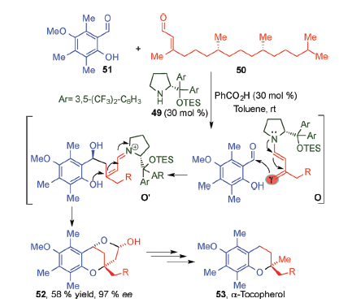
H
Vitamin E
Liu, K.; Chougnet, A.; Woggon, W.-D. Angew. Chem. Int. Ed.
2008, 47, 5287.

Slide 28
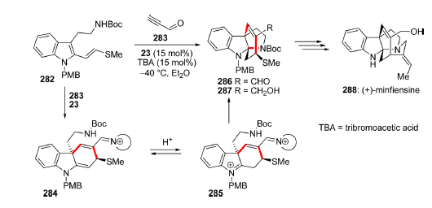
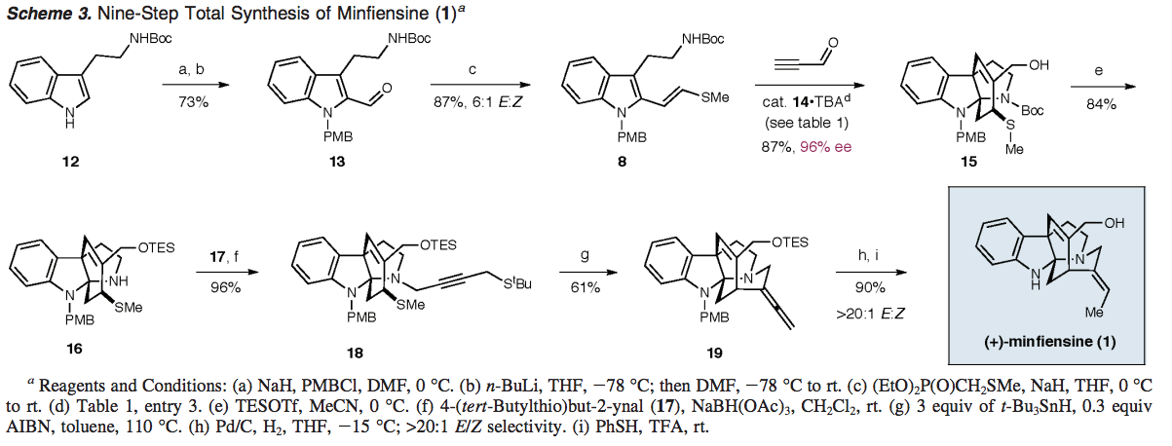
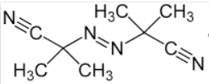
Jones, S. B.; Simmons, B.; MacMillan, D. W. C. J. Am. Chem. Soc. 2009, 131, 13606.

Slide 29
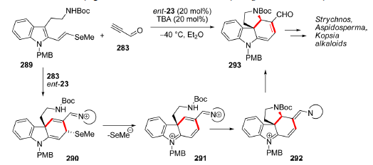
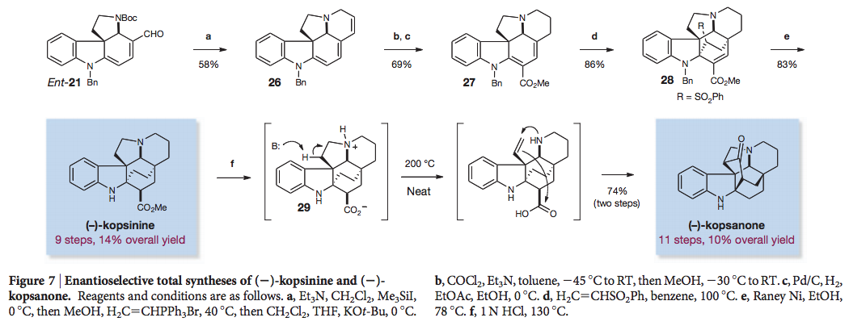
6 total syntheses
≤12 steps
including (-)-kopsanone, with
6 stereocenters, including 2 quat,
and 2 tetrasubstituted stereocenters,
which are all contiguous
Jones, S. B.; Simmons, B.; Mastracchio, A.; MacMillan, D. W. C. Nature 2011, 475, 183.

Slide 30
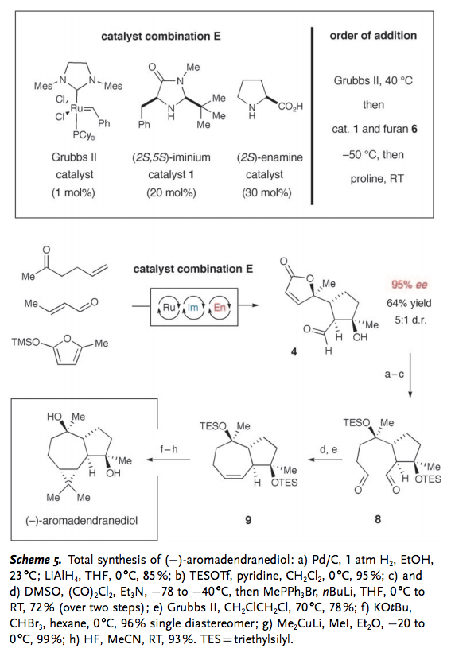
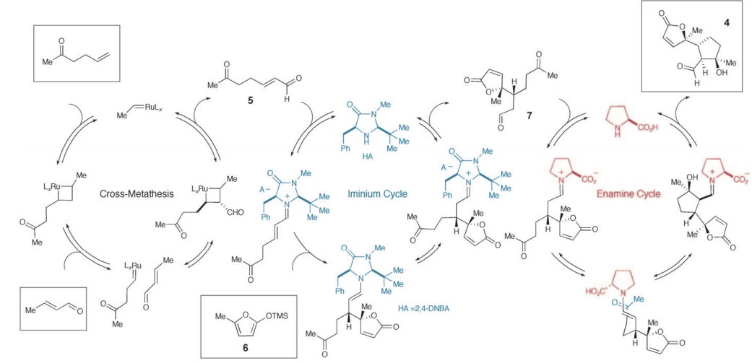
Simmons, B.; Walji, A. M.; MacMillan, D. W. C. Angew. Chem.
Int. Ed. 2009, 48, 4349-4353.

Slide 31
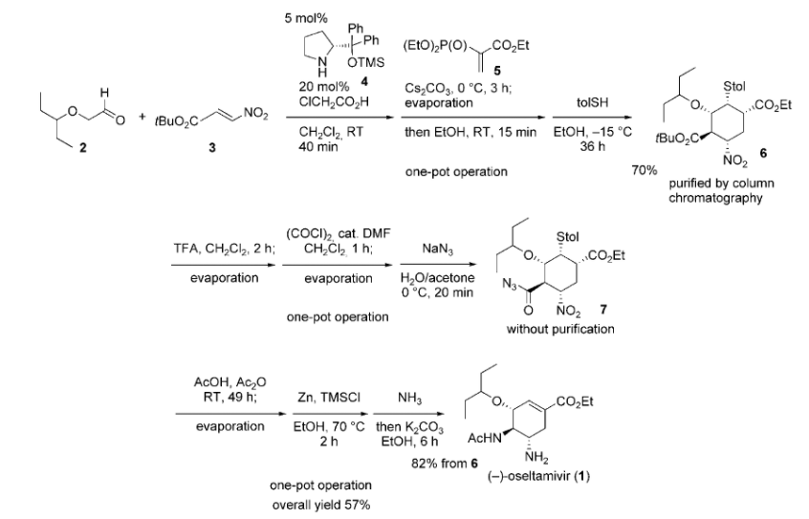
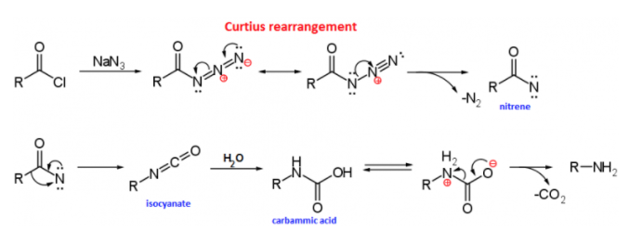
Tamiflu®
2009 H1N1 swine flu pandemic
Ishikawa, H.; Suzuki, T.; Hayashi, Y. Angew. Chem.
Int. Ed. 2009, 48, 1304..

Slide 32
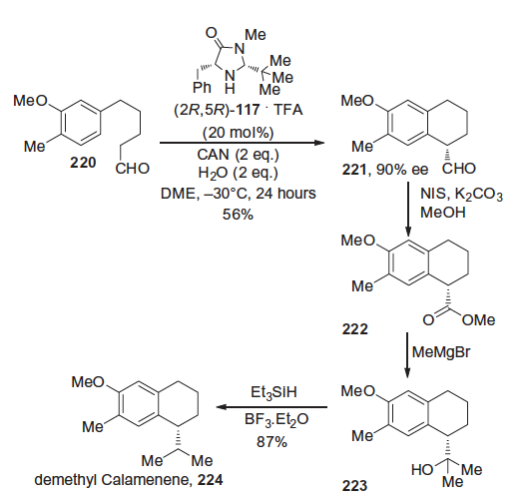
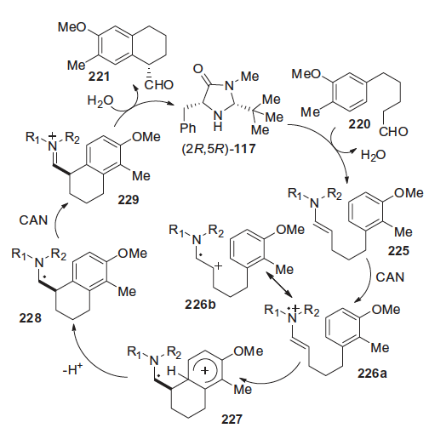
SOMO catalysis in synthesis
Nicolaou, K. C.; Reingruber, R.; Sarlah, D.;
Bräse, S. J. Am. Chem. Soc. 2009, 131, 2086.

Slide 33
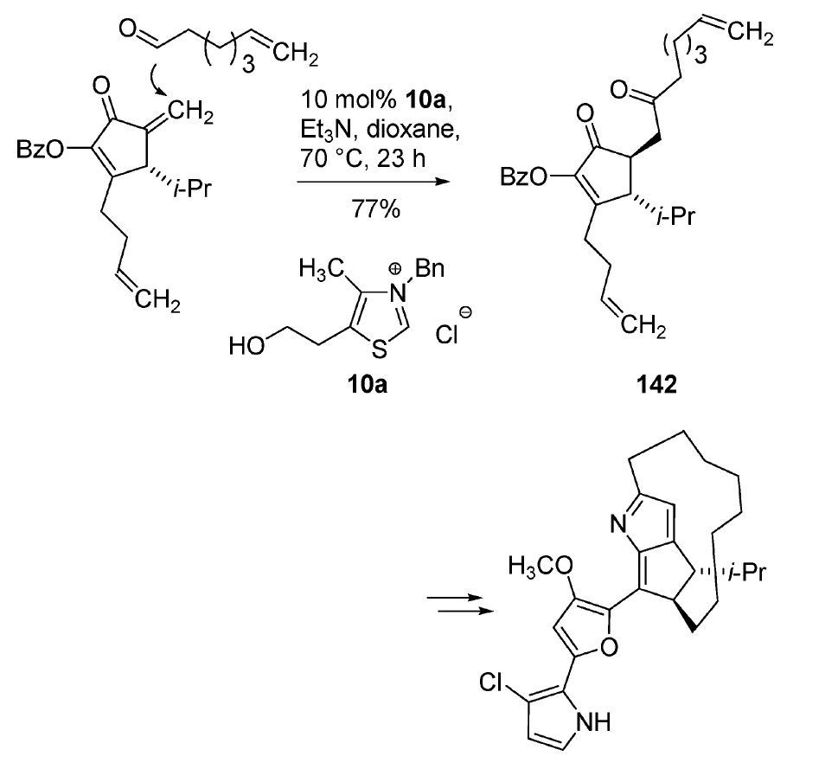
Roseophilin
Harrington, P. E.; Tius, M. A. J. Am. Chem.
Soc. 2001, 123, 8509.

Slide 34
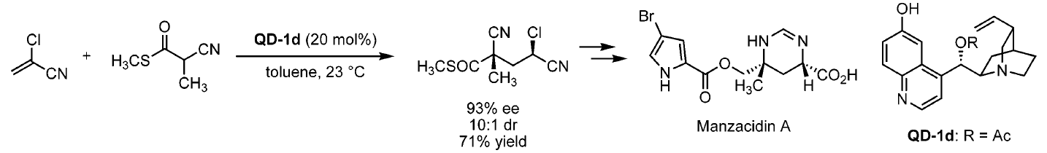
Wang, Y.; Liu, X.; Deng, L. J. Am. Chem. Soc. 2006, 128, 3928.

